Slide 1
Microsoft SSM
Yogesh

Slide 2
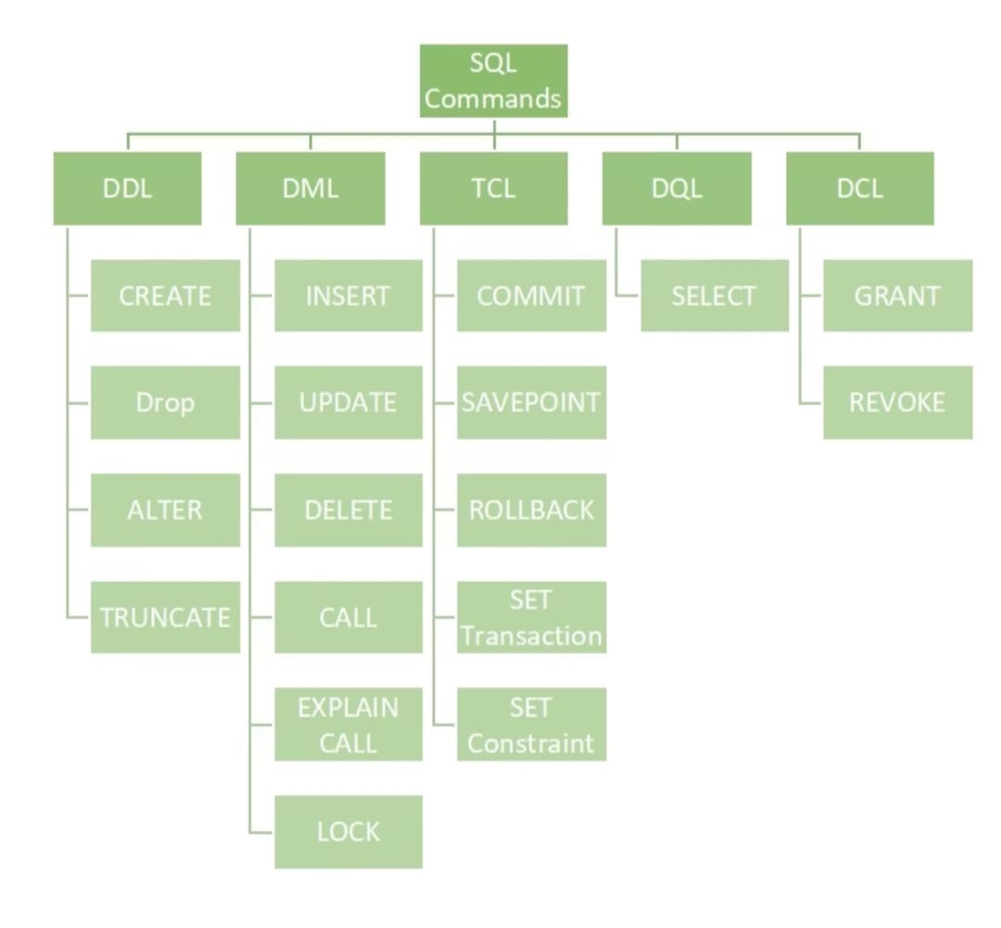

Slide 3
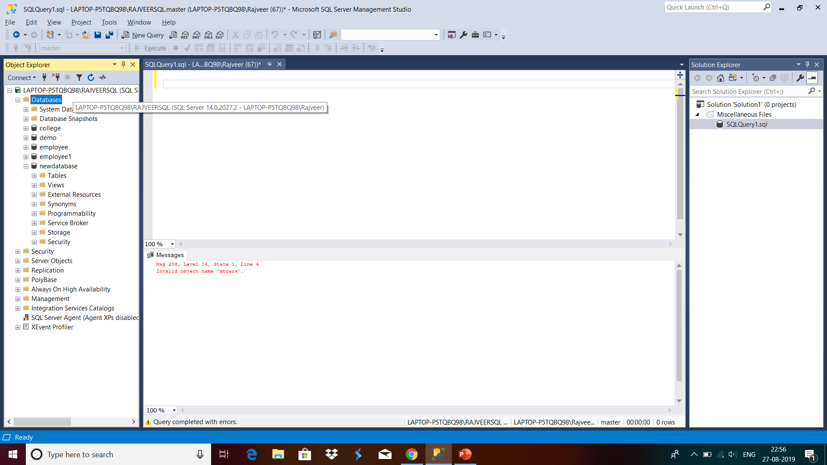
Your first interaction with SQL
Area where we write commands
Area where you can see the executed codes.
Error will be in Red
Object Explorer where you can see the list of files

Slide 4
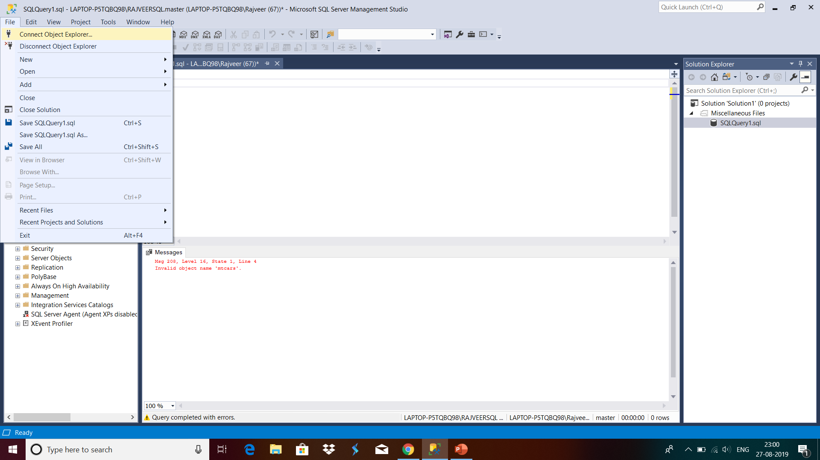
Most important in corporate-Connect with Object

Slide 5
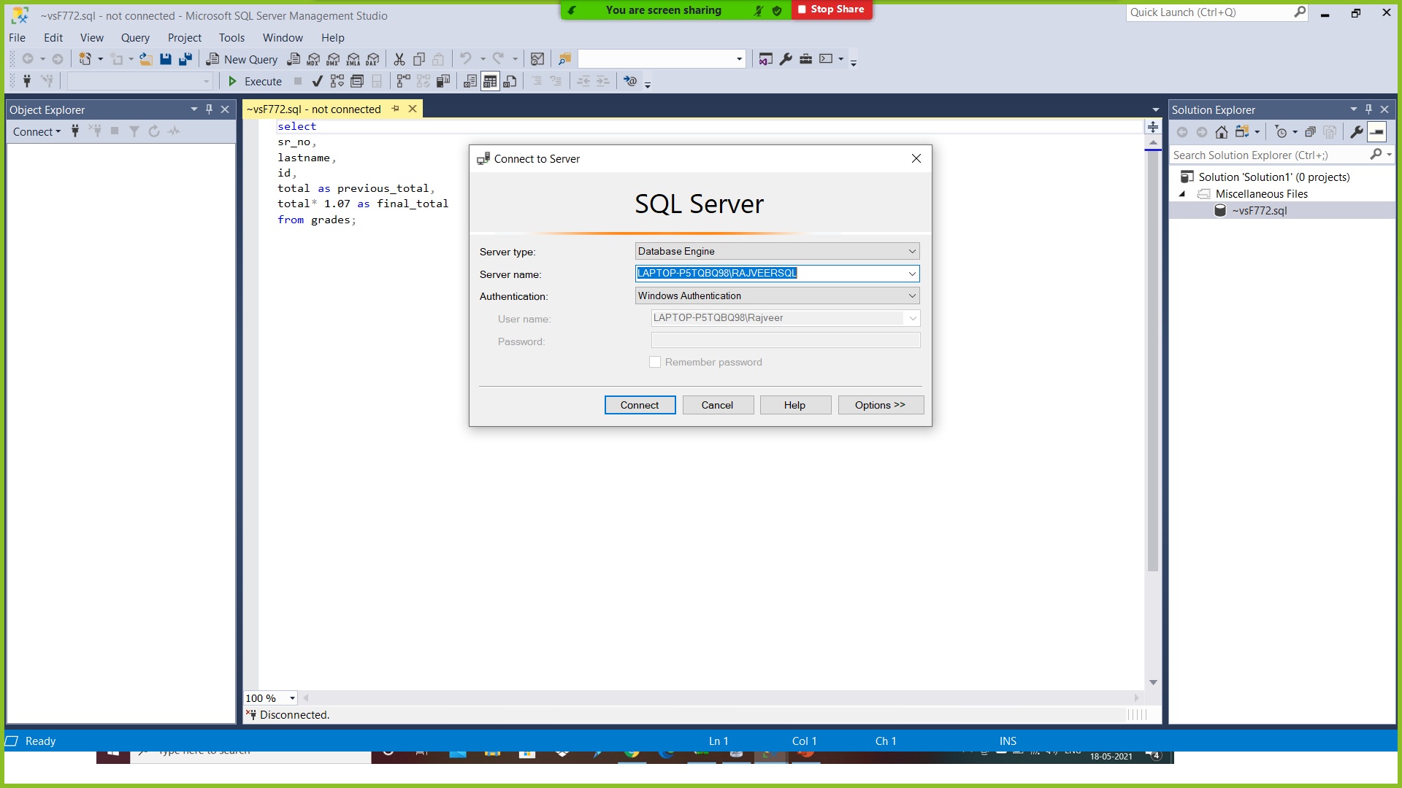
Most important in corporate-Connect with Object
Click on connect

Slide 6
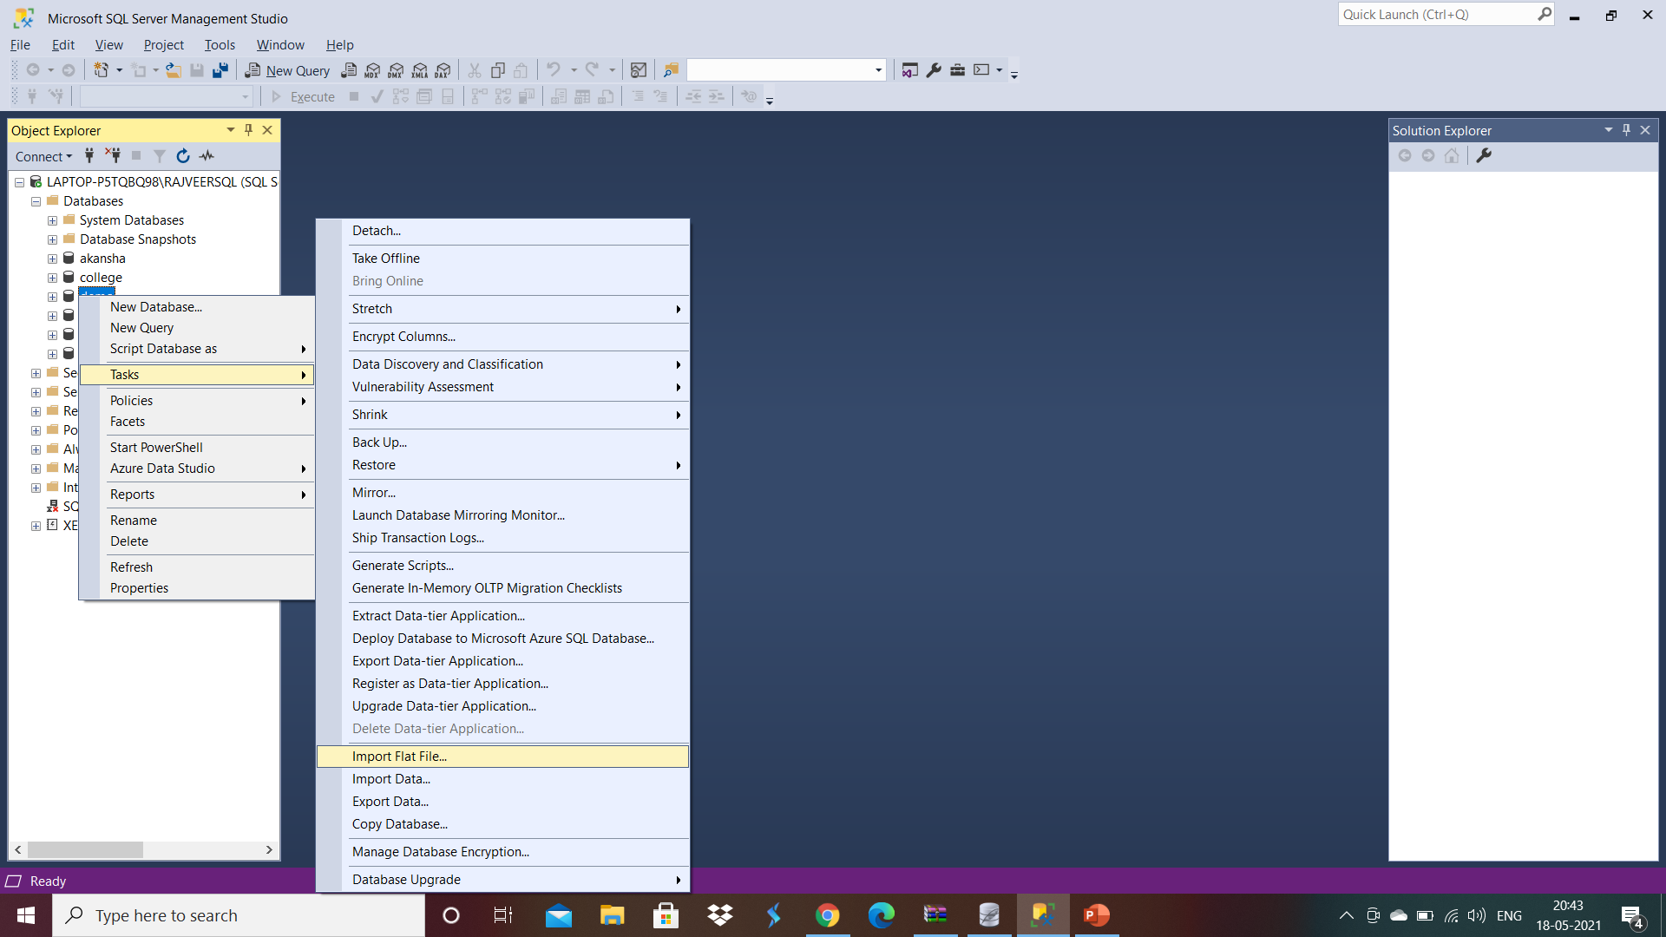
Add File to Database

Slide 7
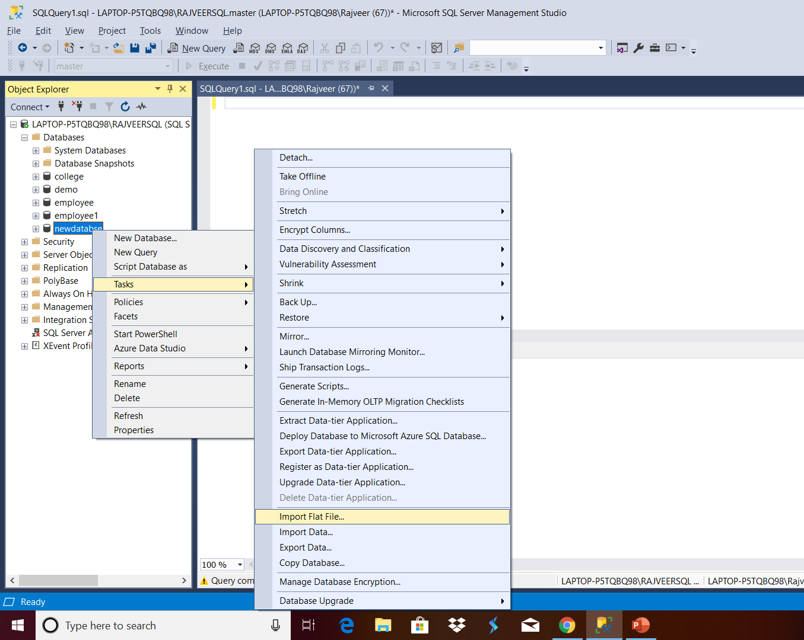
Adding Files in already created database.
Now right click on the created database(newdatabase in our case) then click on Tasks and then click on Import Flat File… for adding csv files.
CSV-Comma separated Values(sometimes Variables also) are the most common files in internet because it is not affected by any formatting and different software(i.e Excel, R, Python, Tableau, Hadoop and Watson) can use.

Slide 8
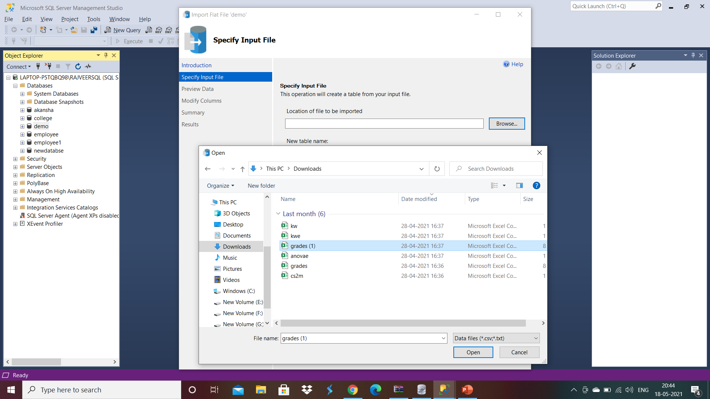
Select File
Click on Browse to select file
Select Grades.csv for further work

Slide 9
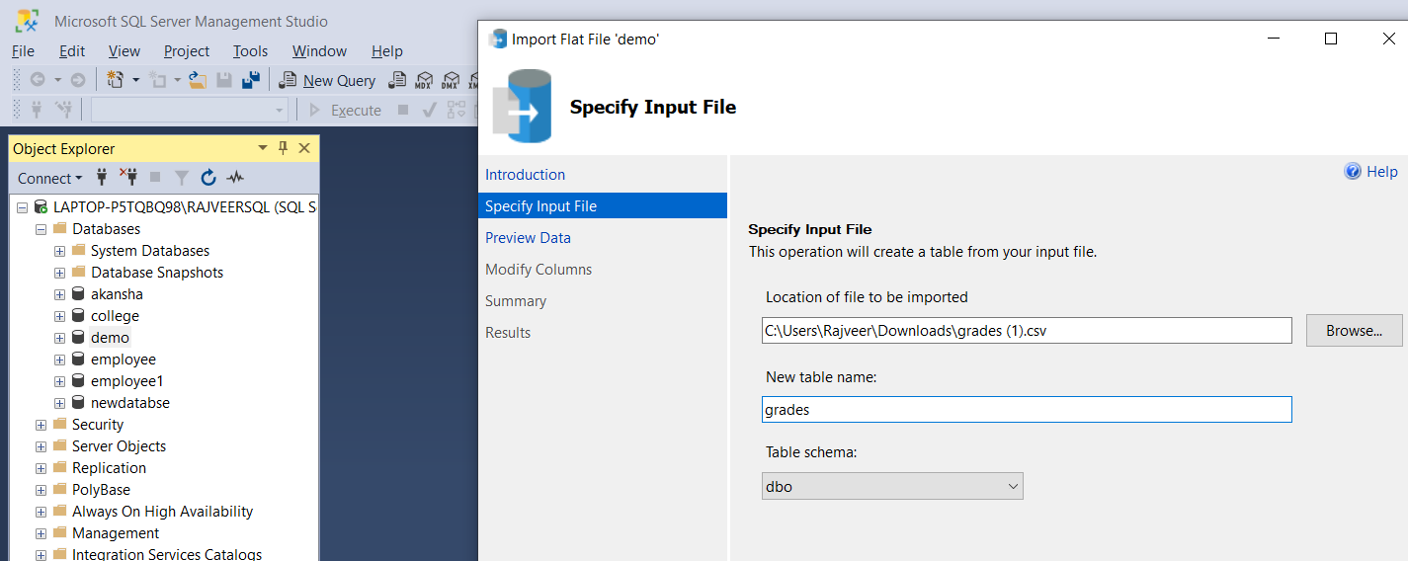
Change the file name and schema(if required)
Change the name of the file according to your need
We can change the schema also

Slide 10
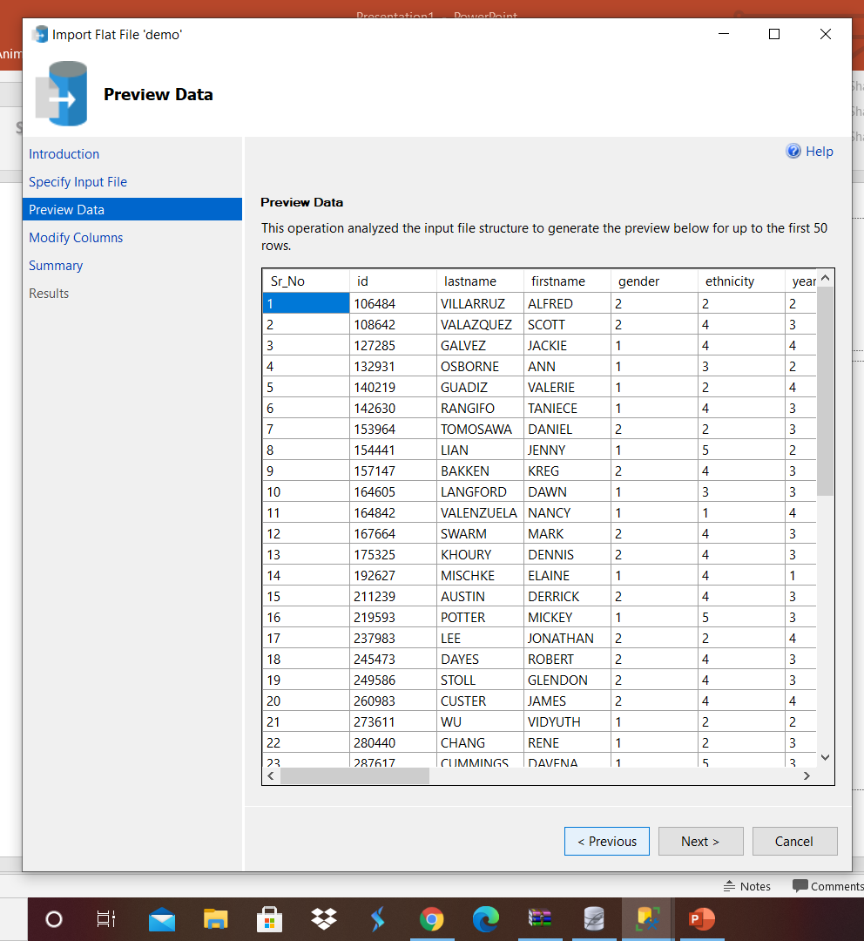
To check the preview
Click next if you are satisfied with Preview

Slide 11
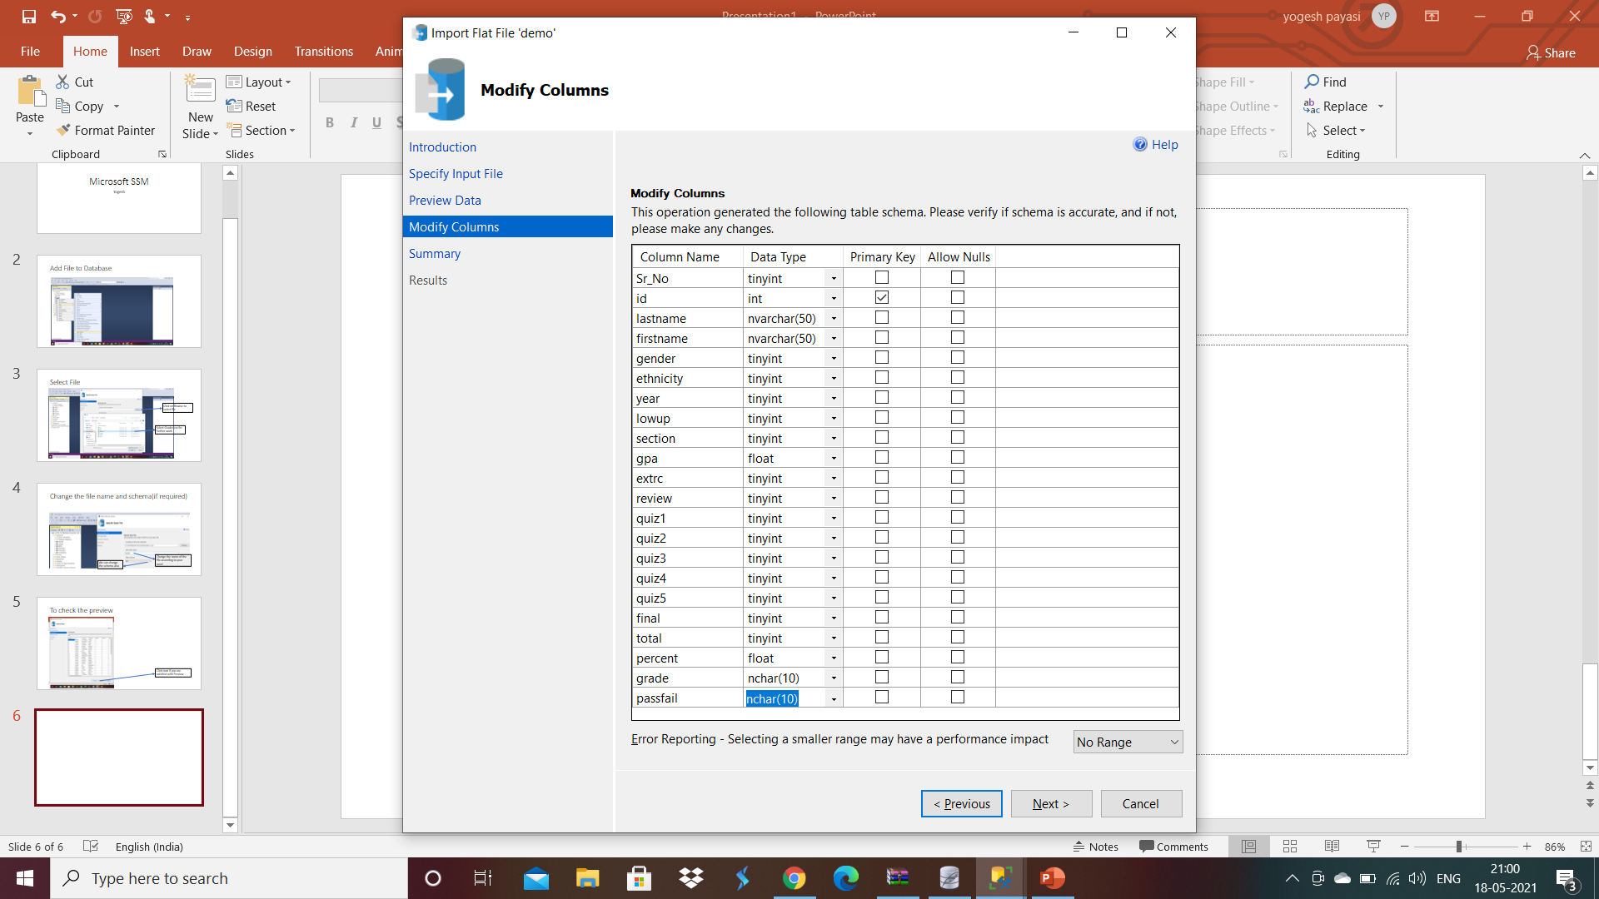

Change Data Type if required and select PRIMARY KEY
Primary Key selection

Slide 12
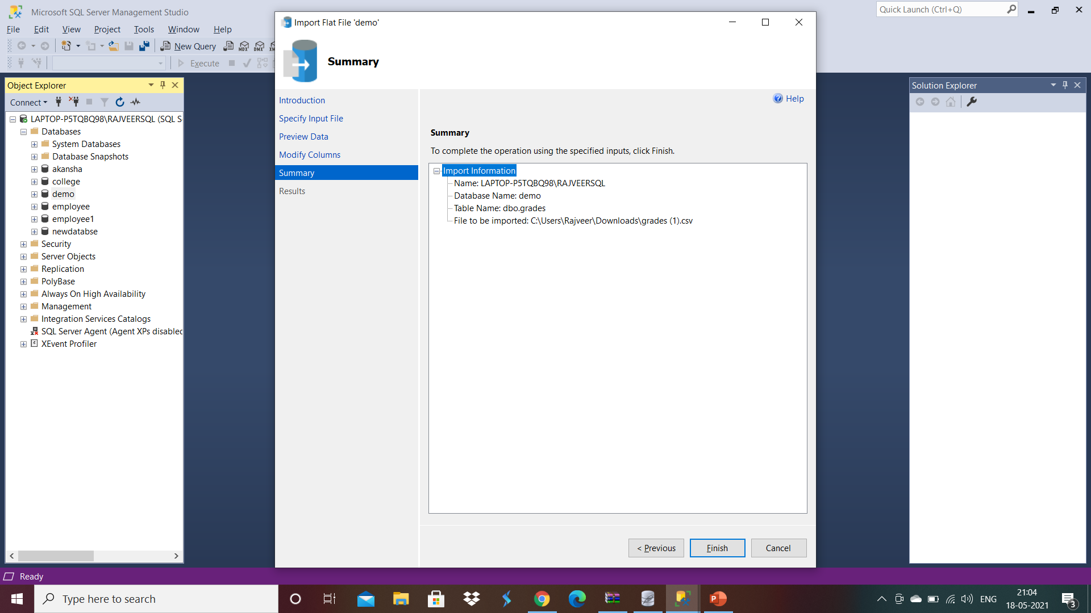
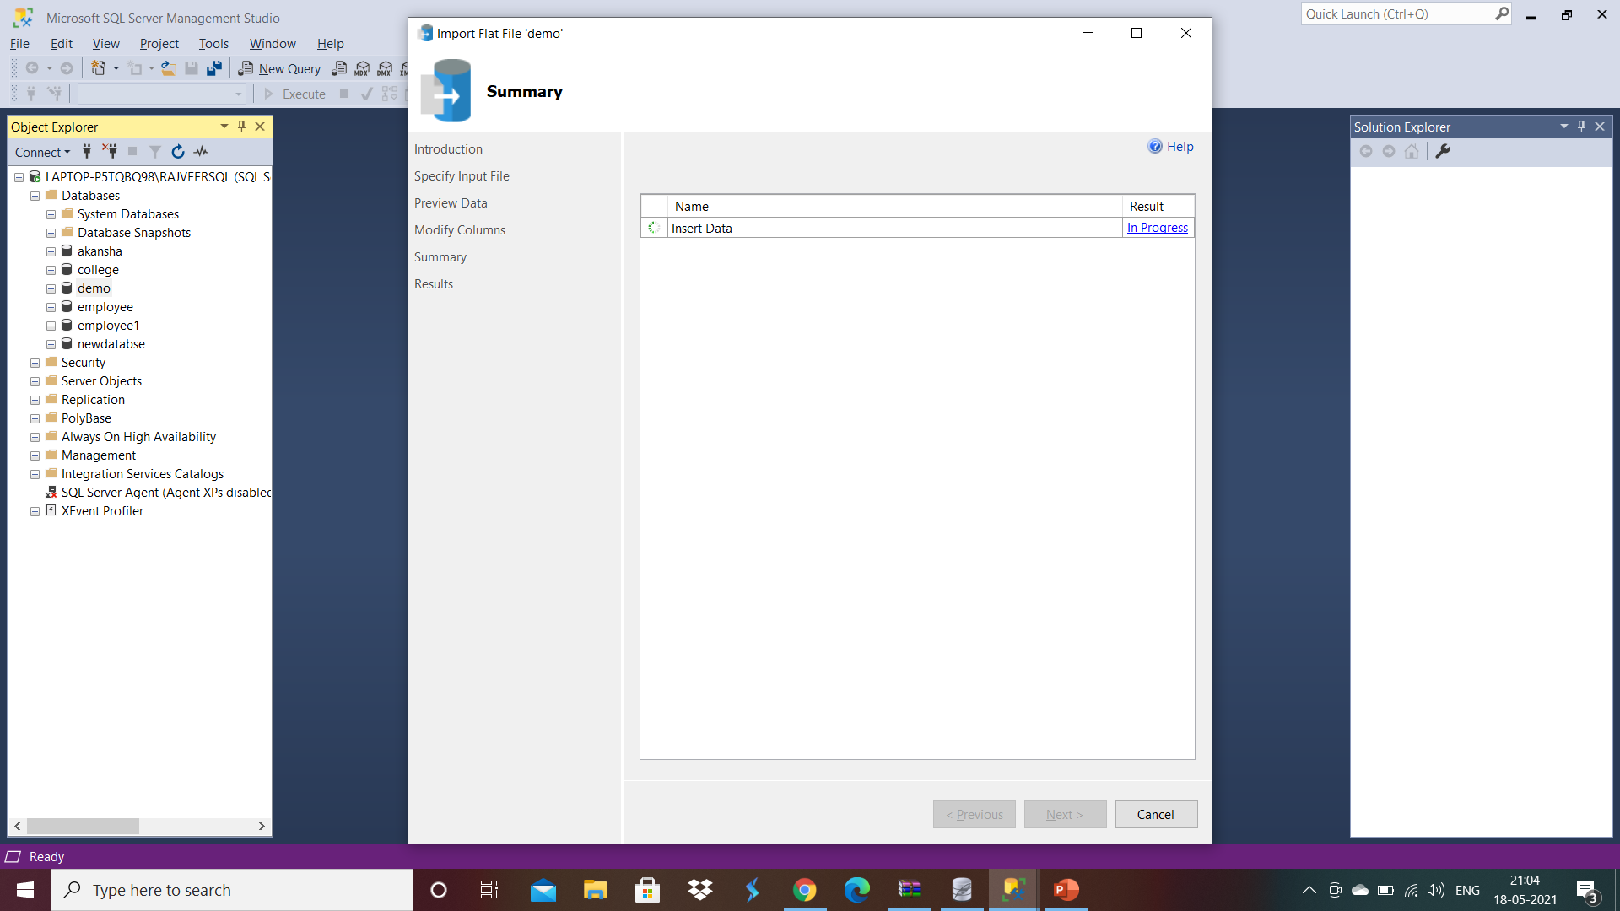
Click Next and if looks file then click Finish- The next screen will wait for process and if everything goes well then it will successfully import the file

Slide 13
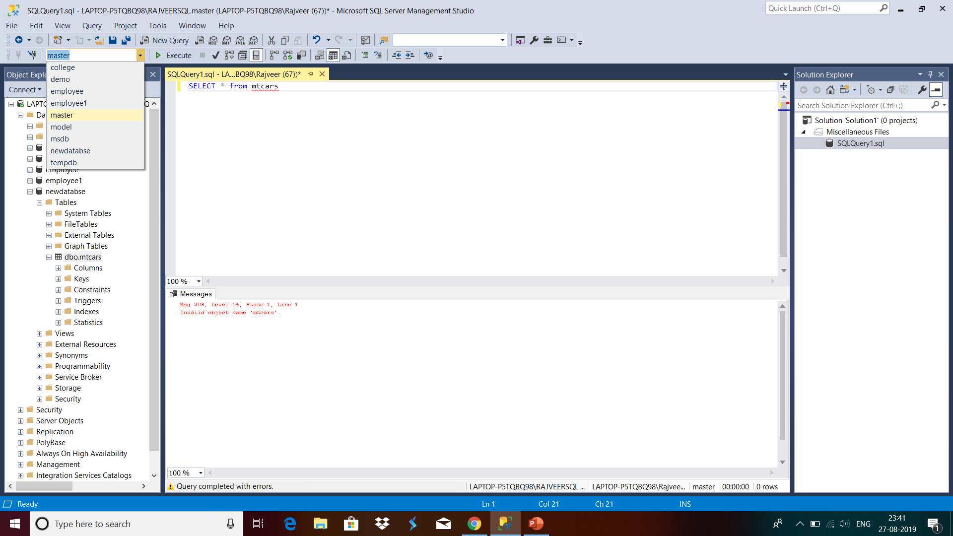
Master to newdatabase
Thinking that are we going to work with master. The answer is no you have to select the database in which you want to work which is new database in our case

Slide 14
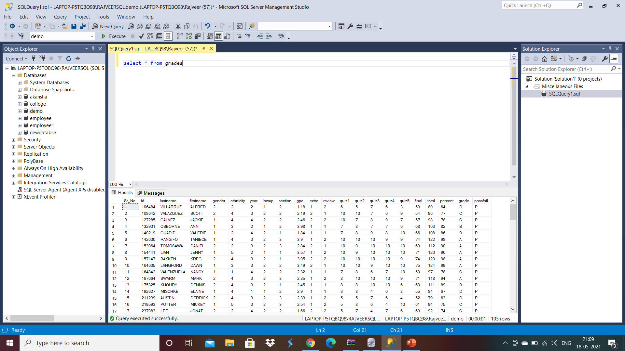
Click on new Query and try to write your first Query and press F5 to execute the query.

Slide 15
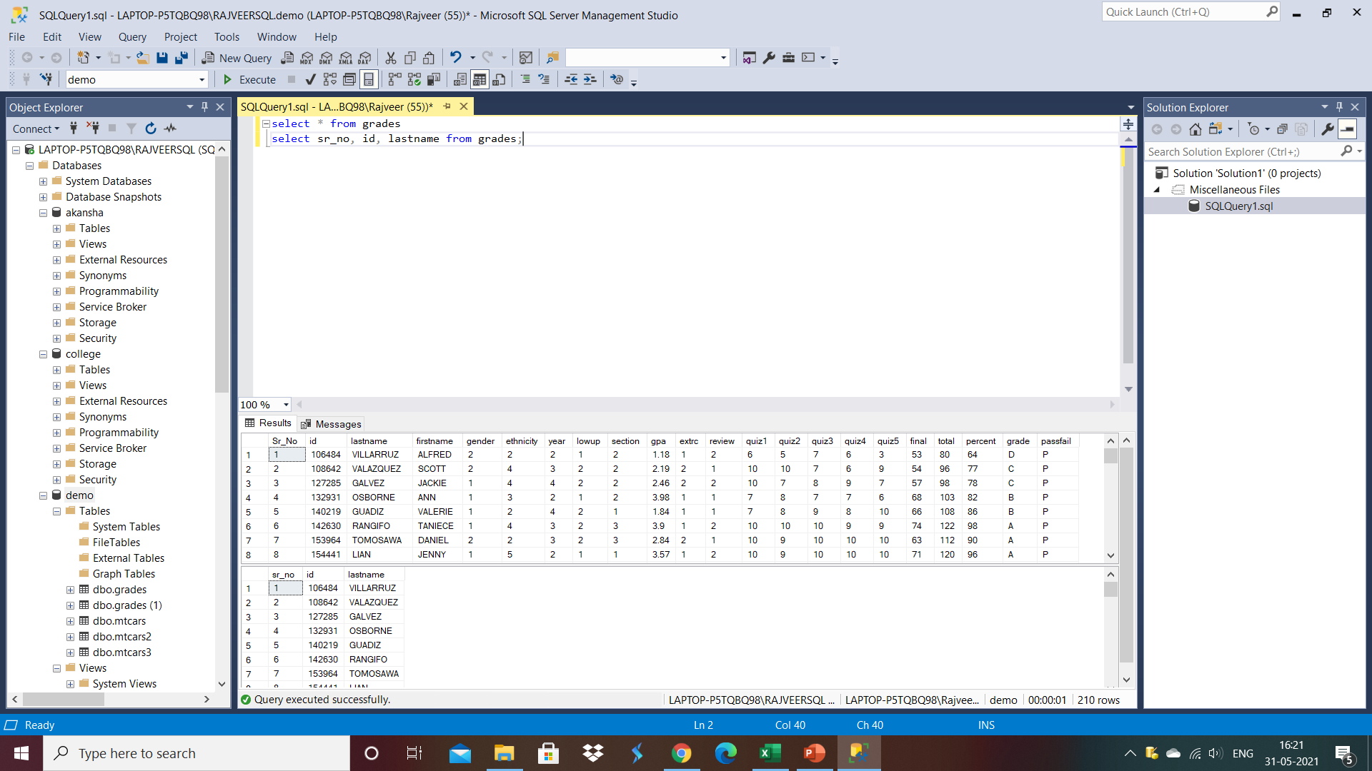
Select query’s in diffrernt ways
Select query having lots of shades.

Slide 16
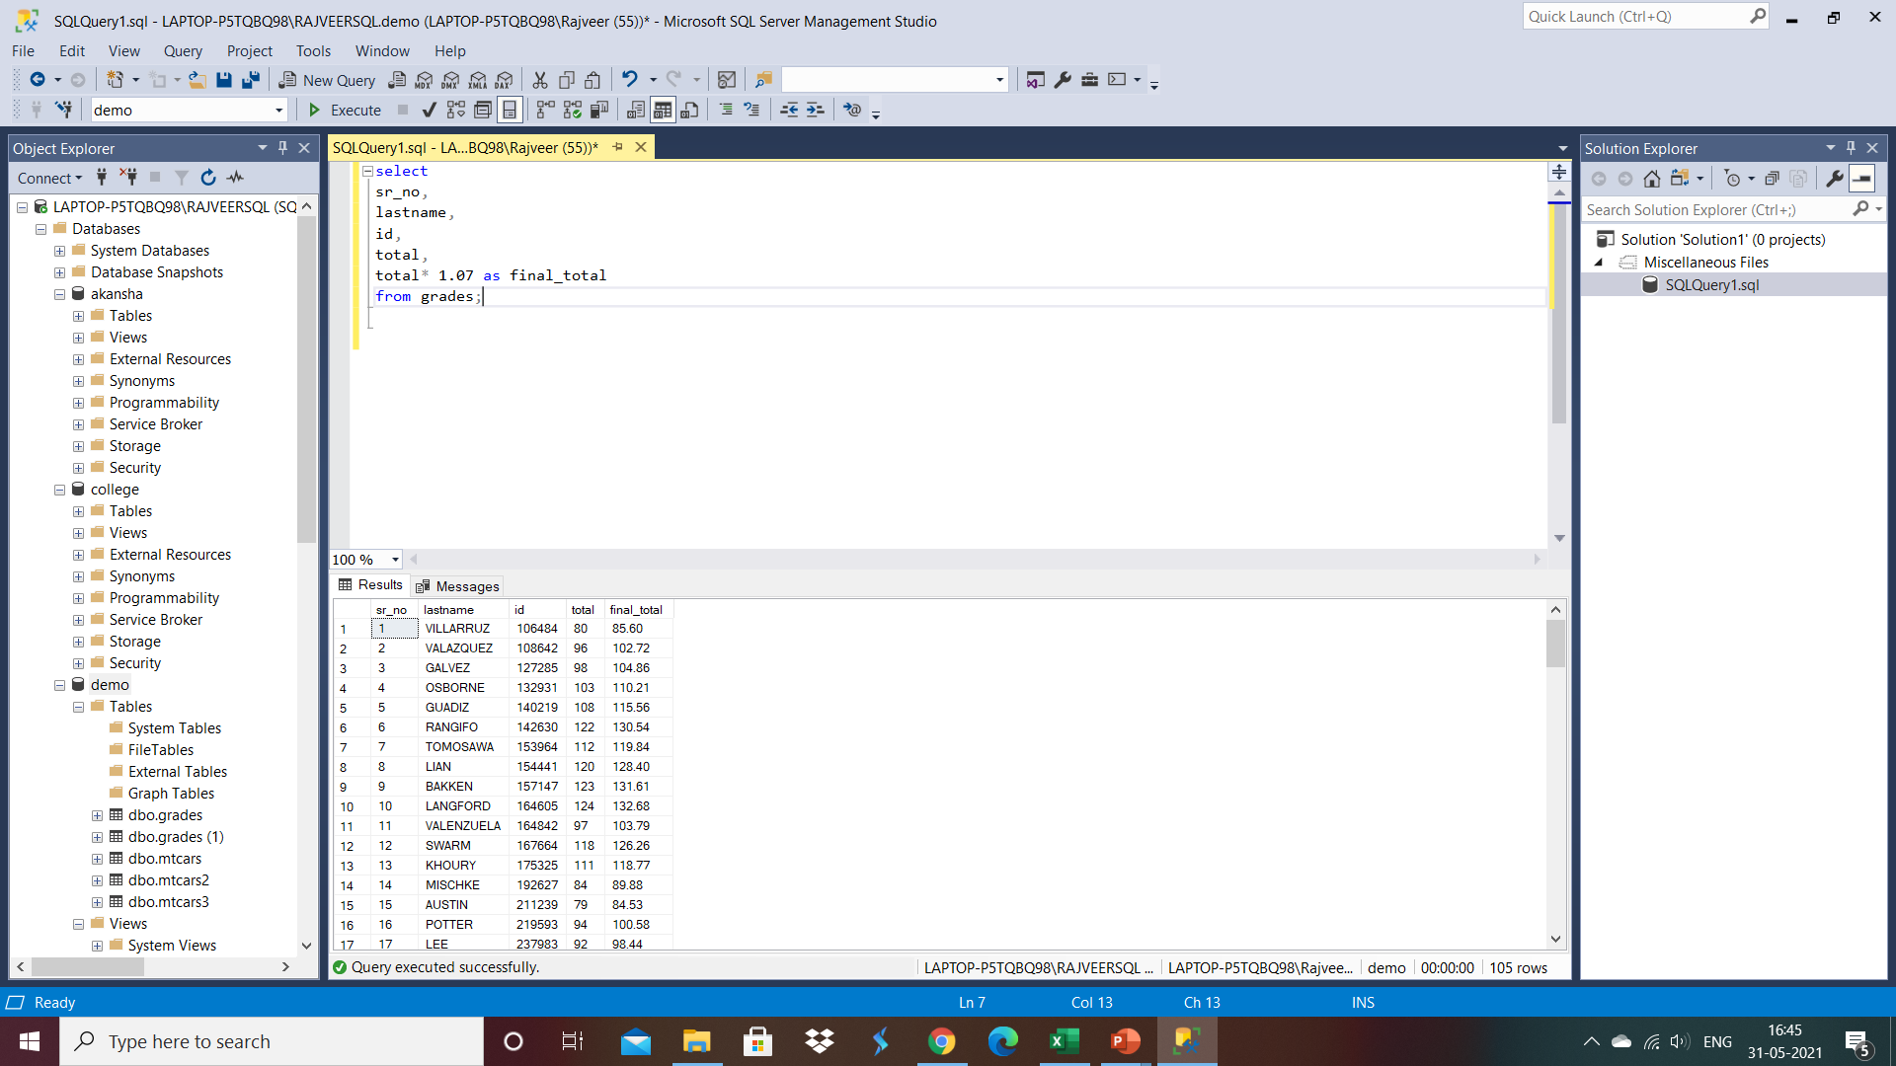
Expression in select statement(1)
Select query having multiplication in in colomun and make a new table with new name

Slide 17

Using AS in Select statement
Using AS for new name of existing table.

Slide 18
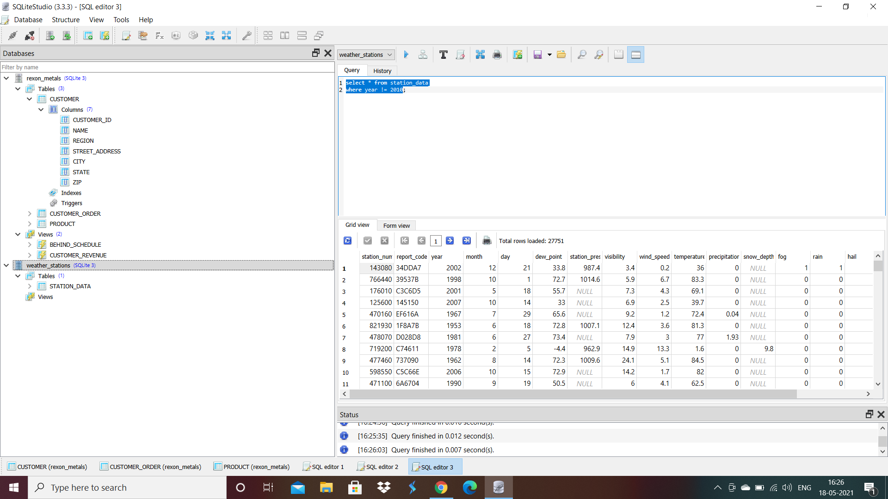
Where?

Slide 19
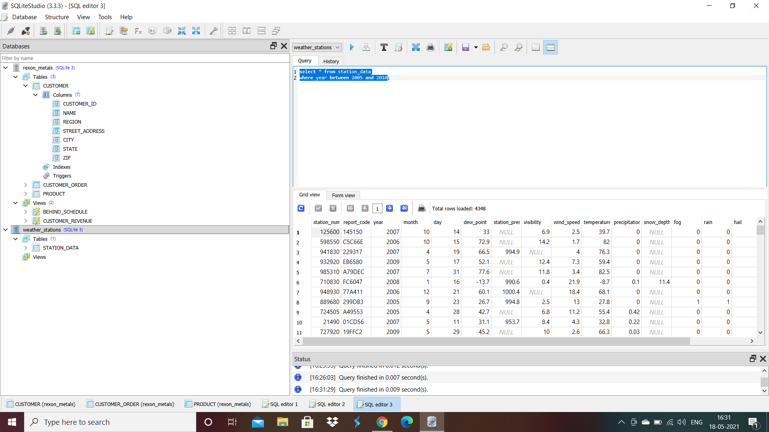

Slide 20

OPERATORS
WHERE,>,<

Slide 21
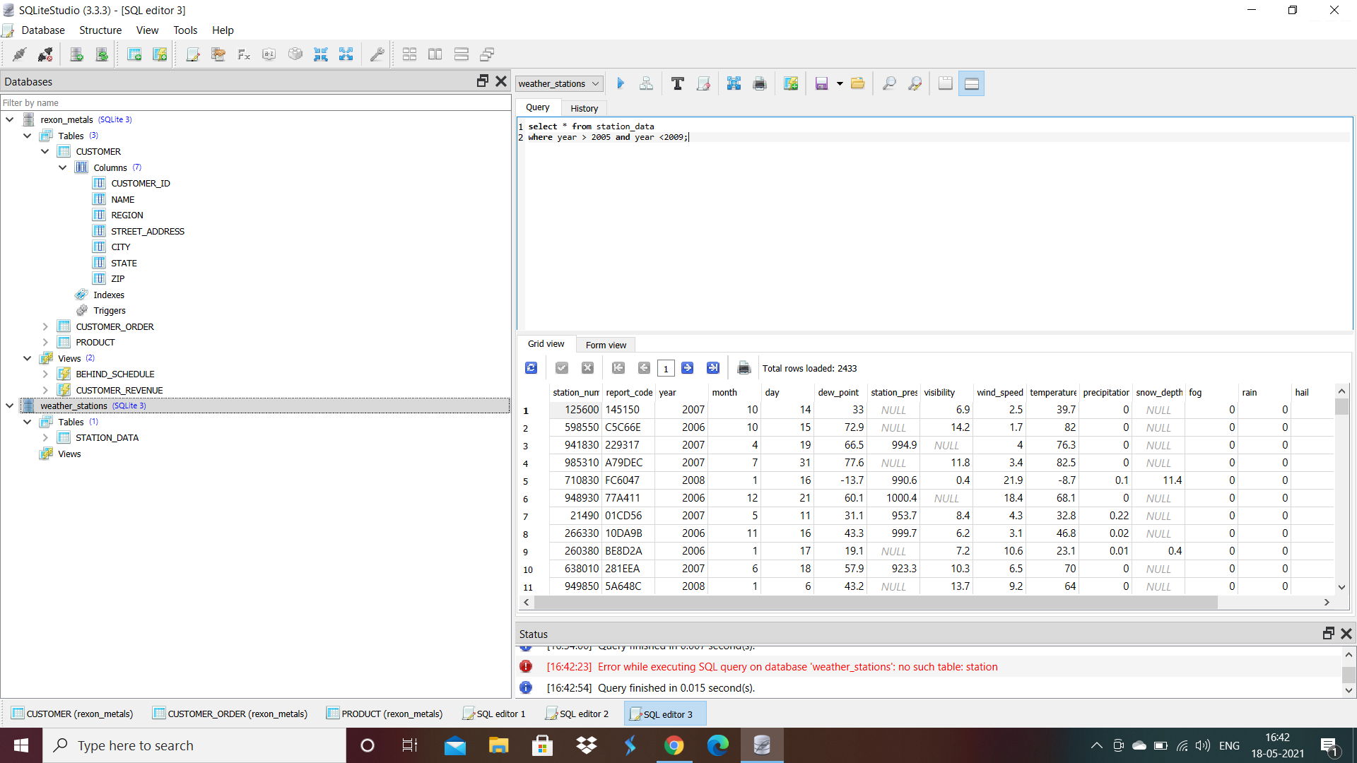
AND OPERATORS

Slide 22
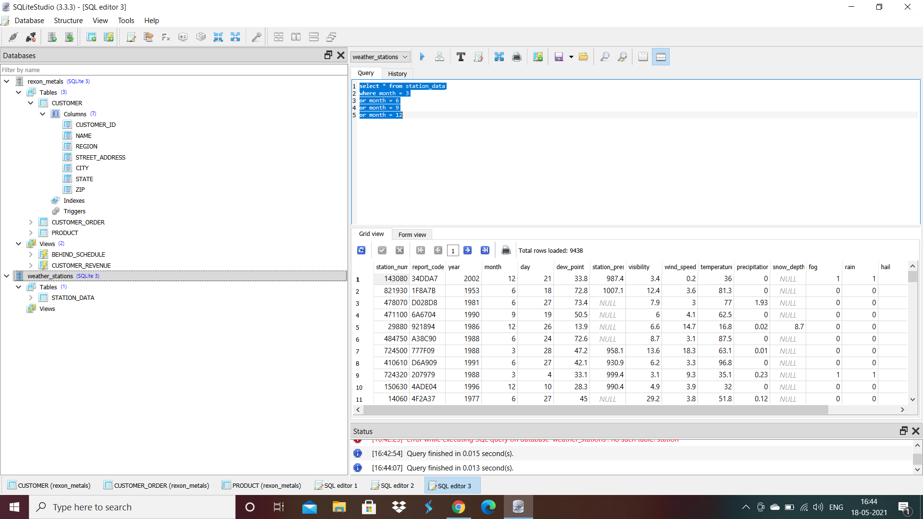
OPERATORS

Slide 23
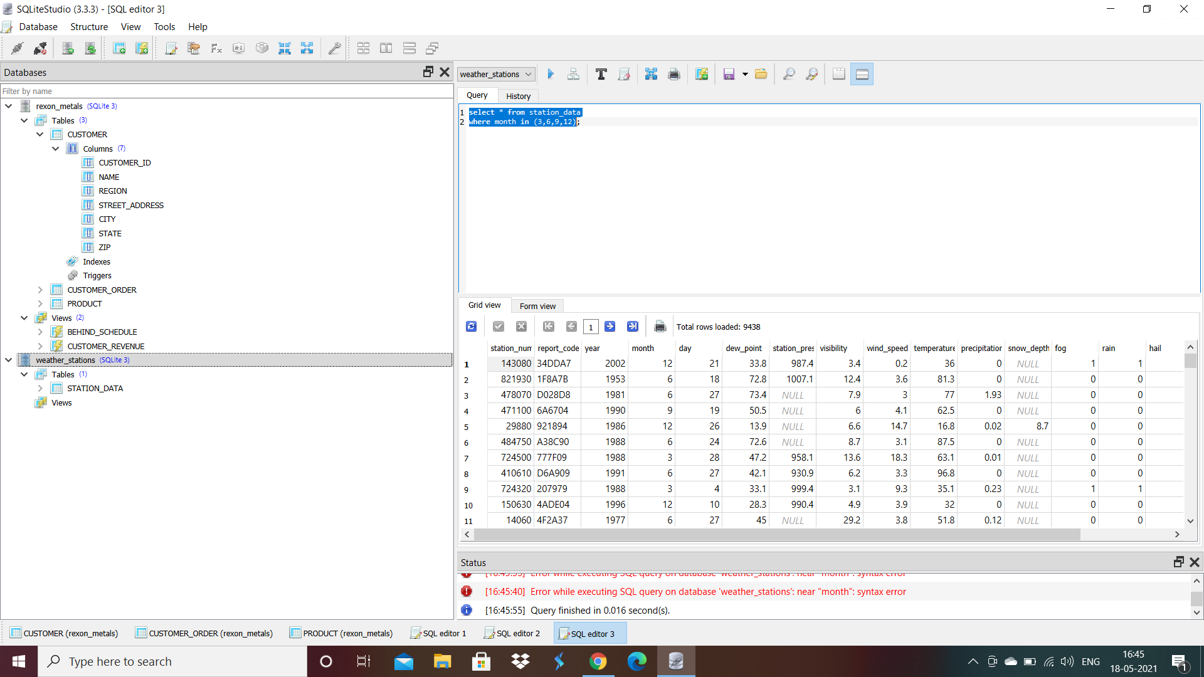

Slide 24


Slide 25
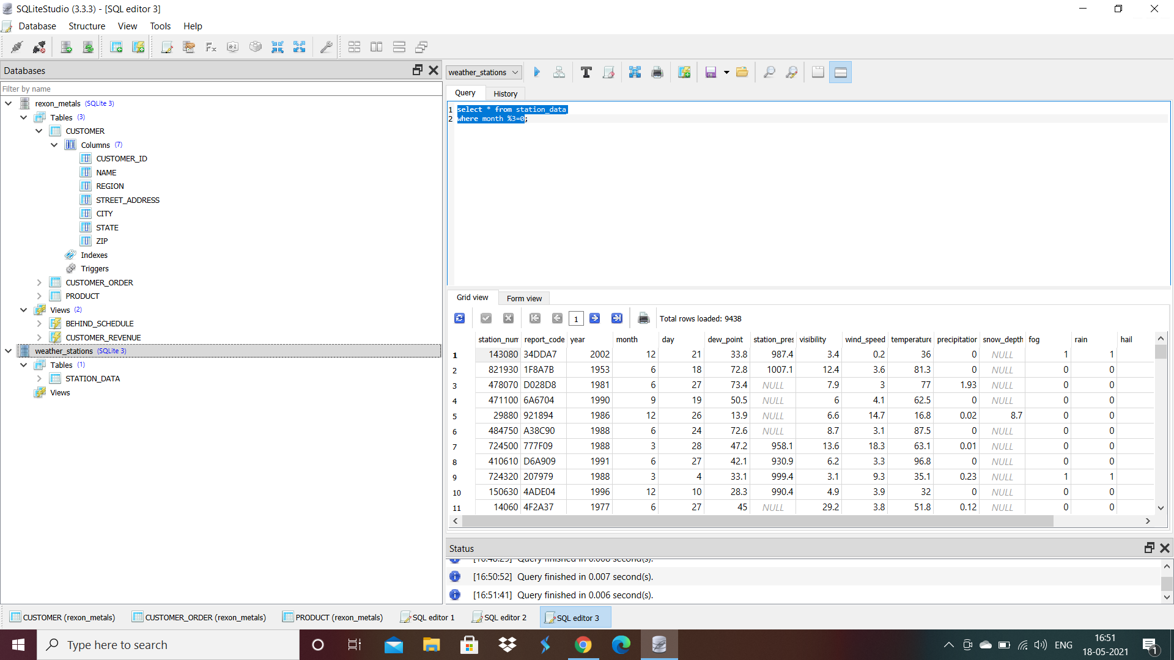

Slide 26

REMEMBER

Slide 27
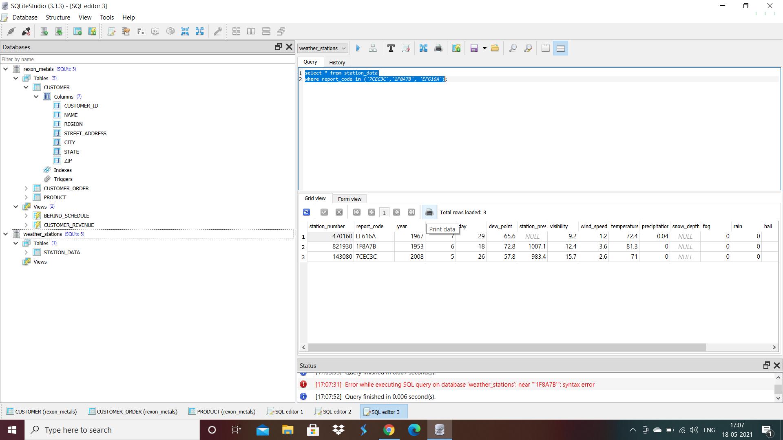

Slide 28
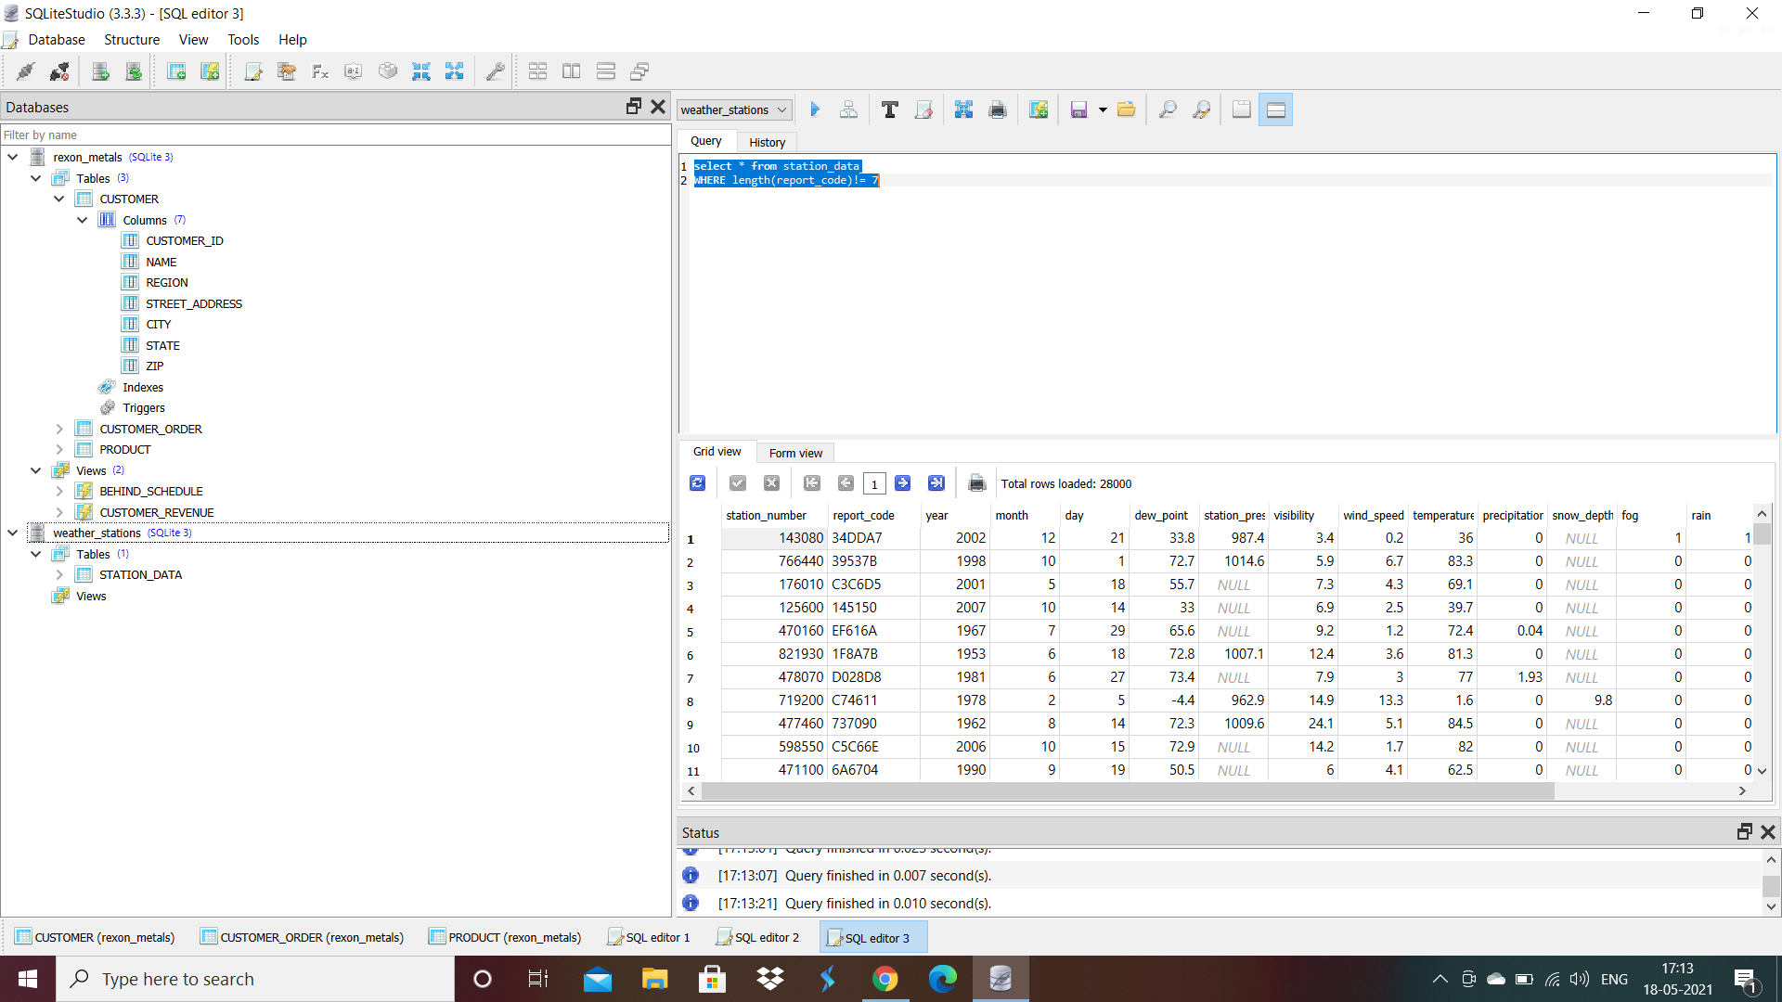

Slide 29
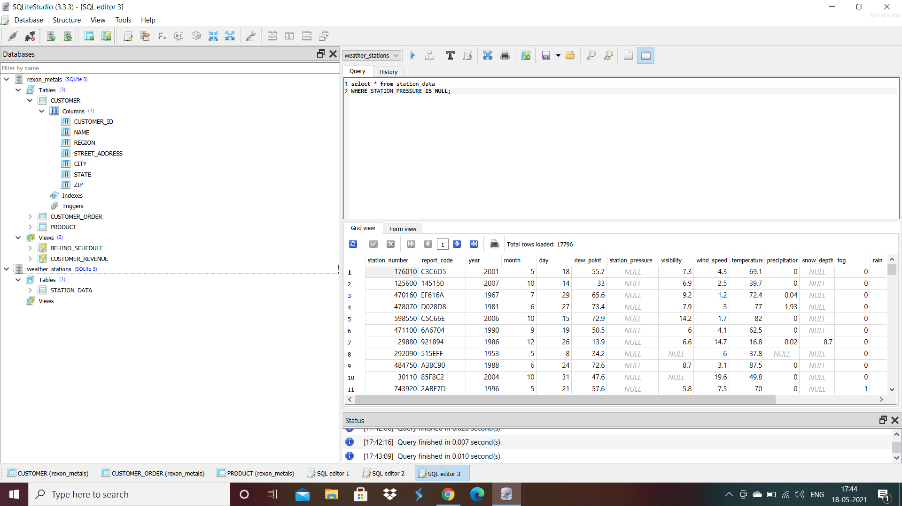

Slide 30
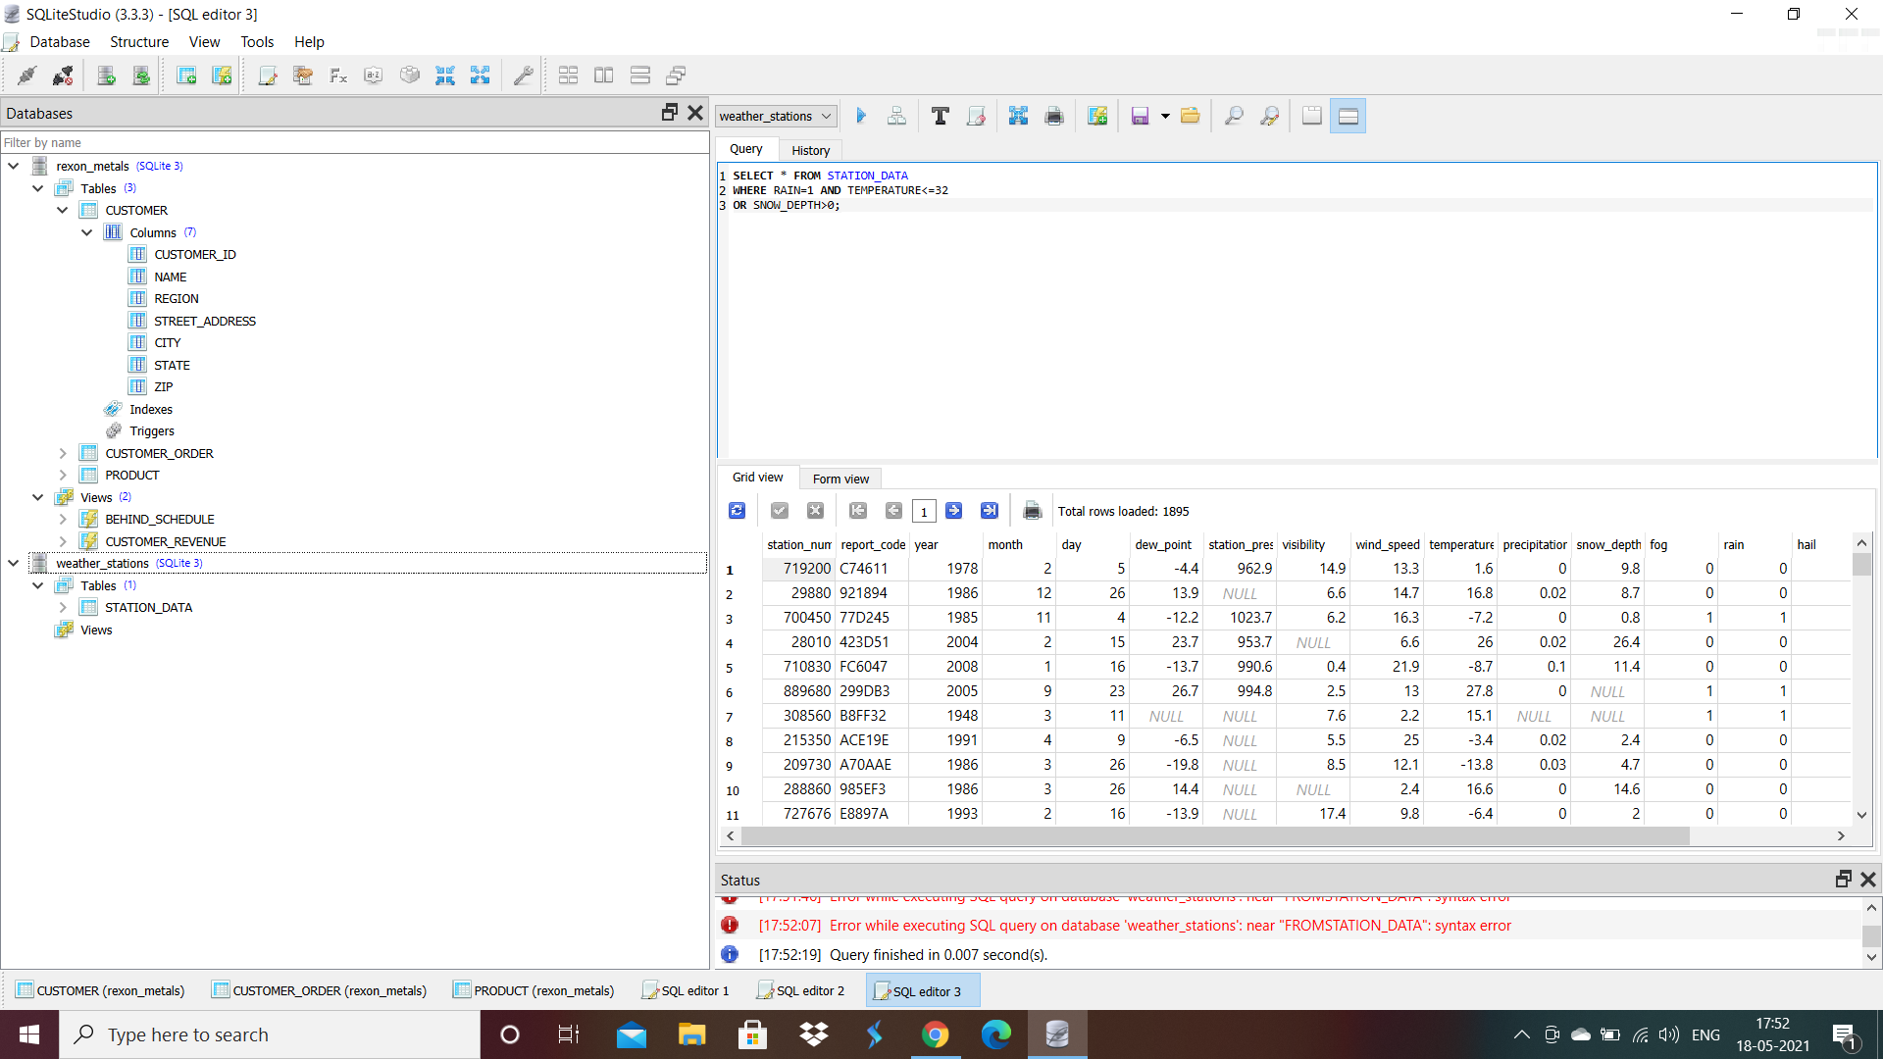

Slide 31
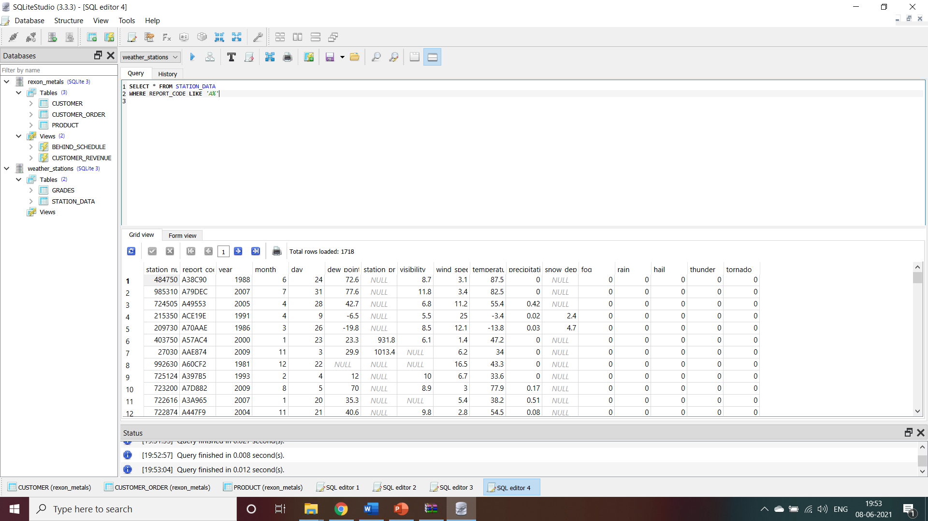

Slide 32
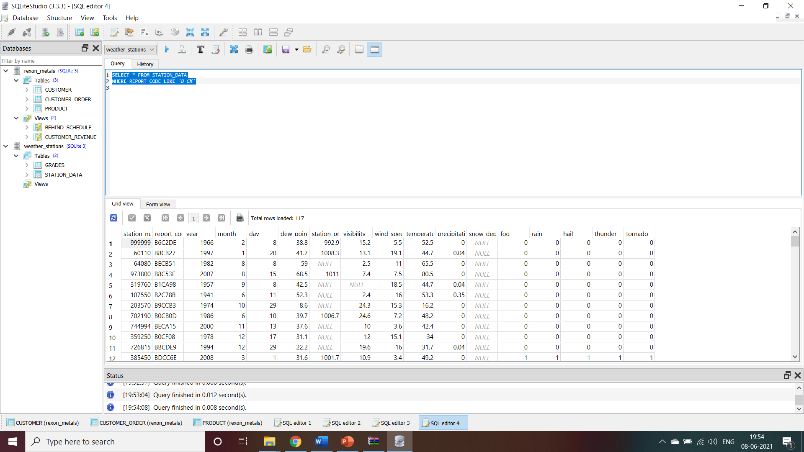

Slide 33
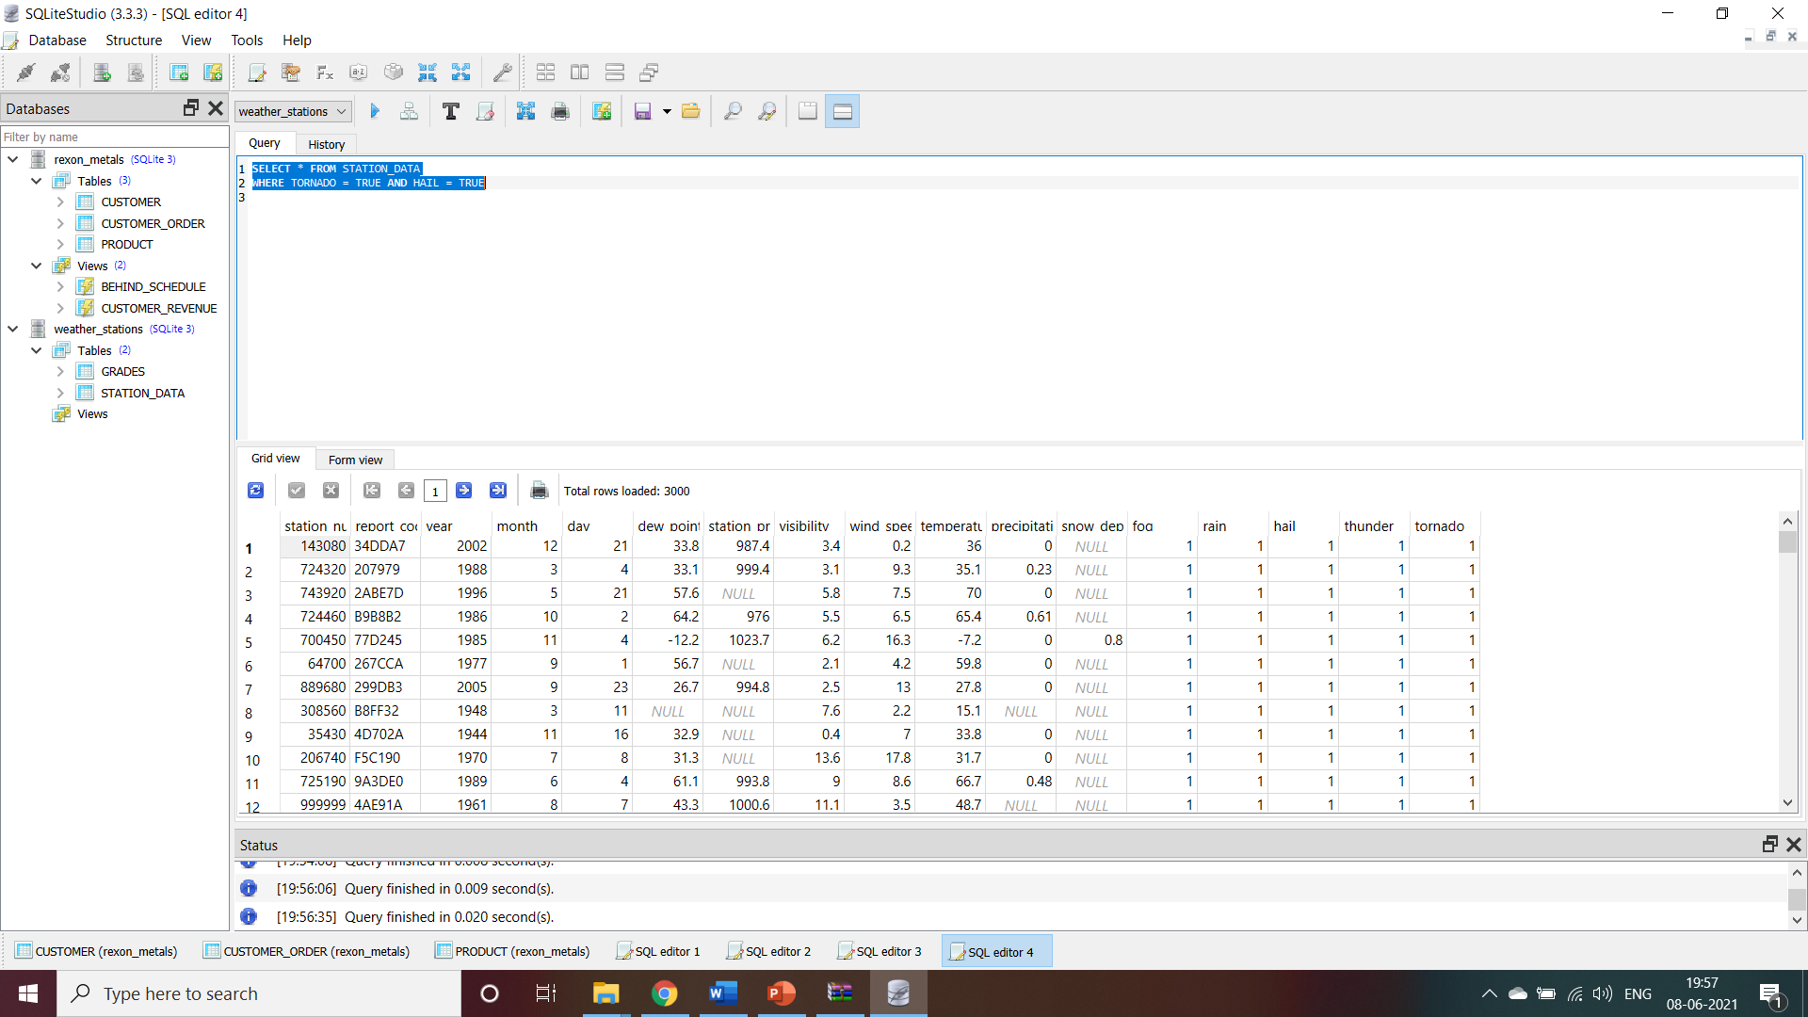

Slide 34
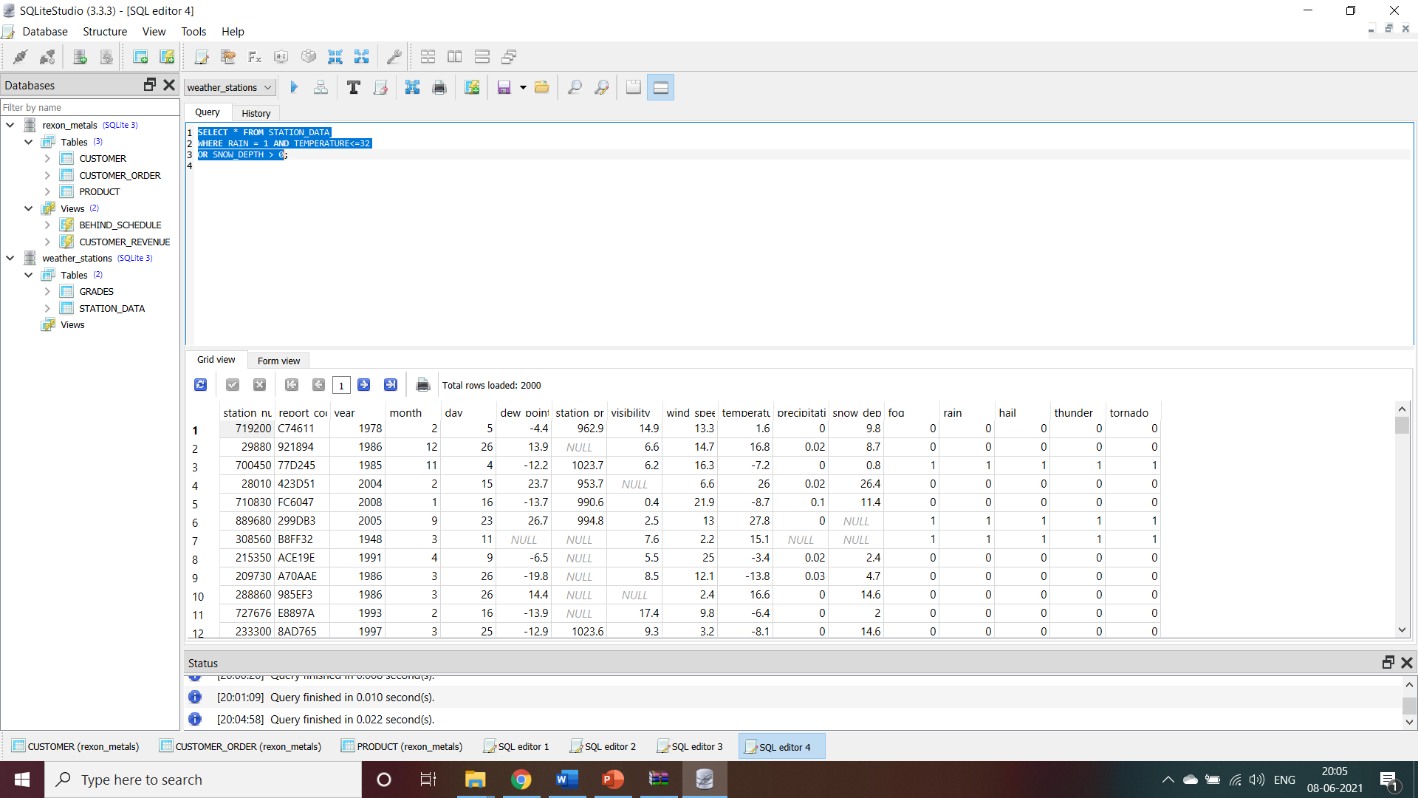

Slide 35
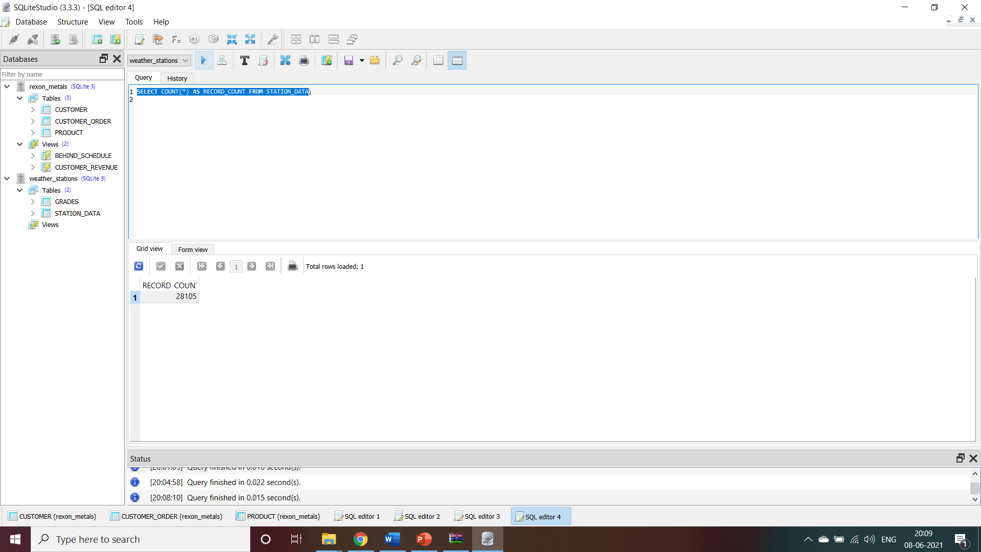

Slide 36
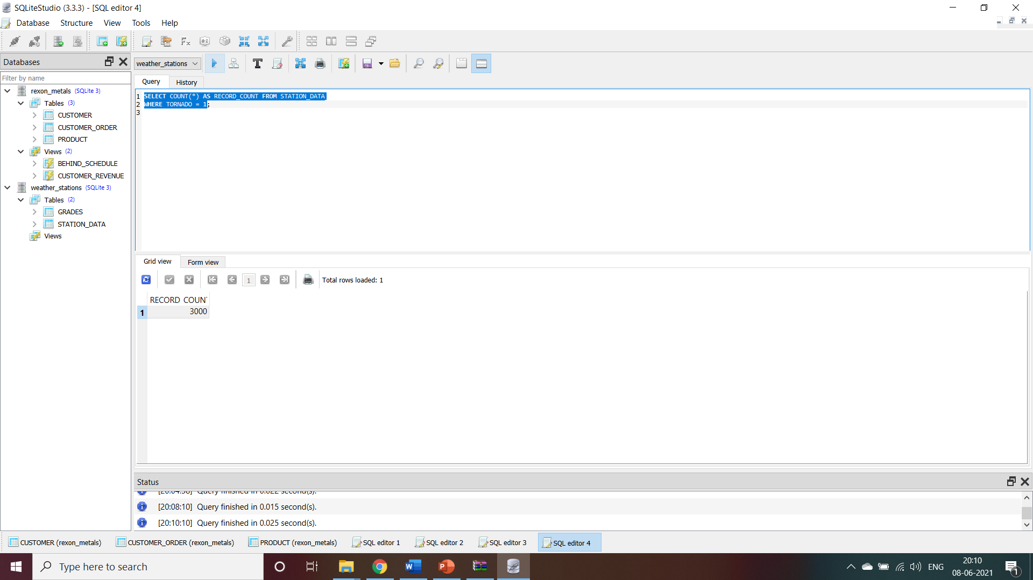

Slide 37
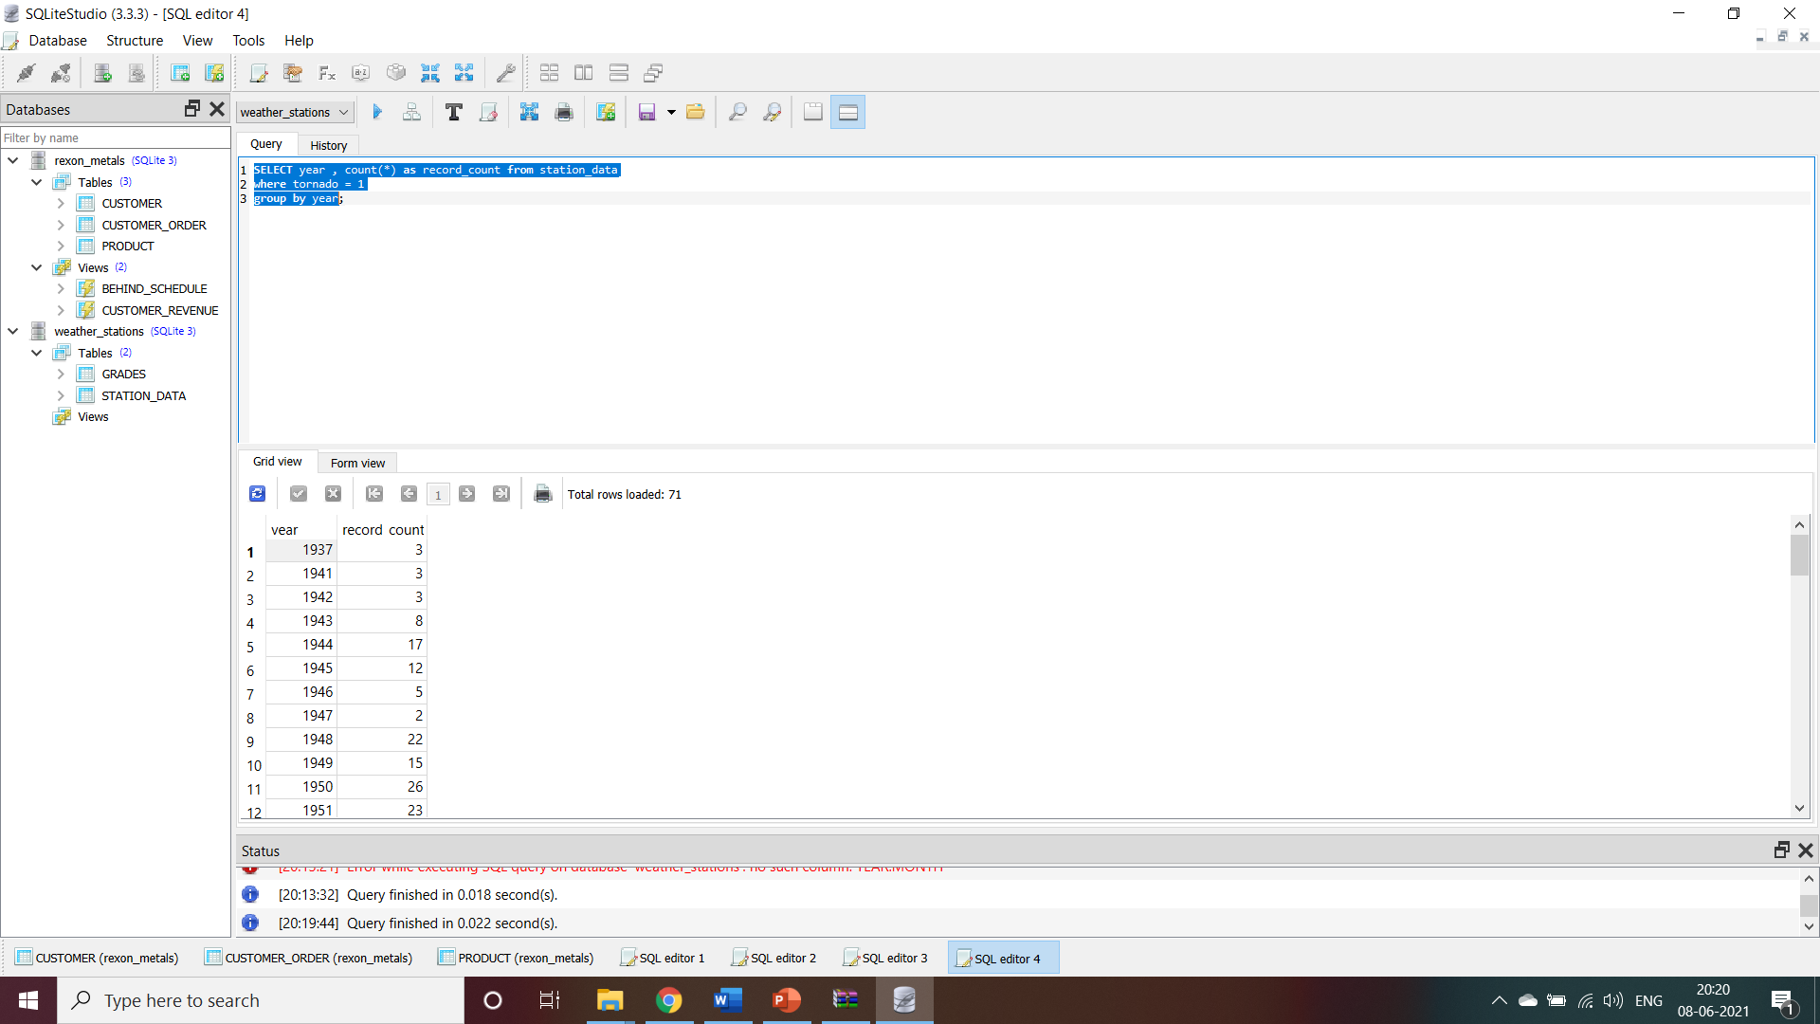

Slide 38
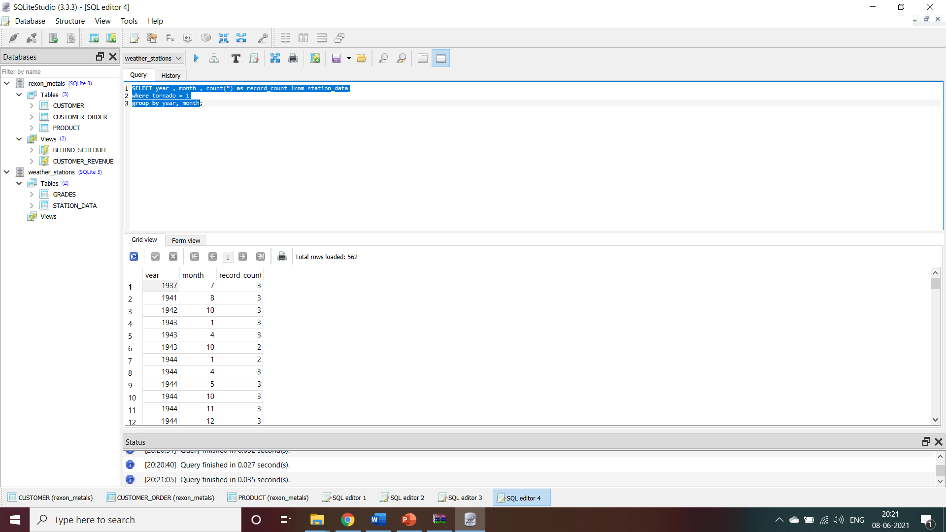

Slide 40
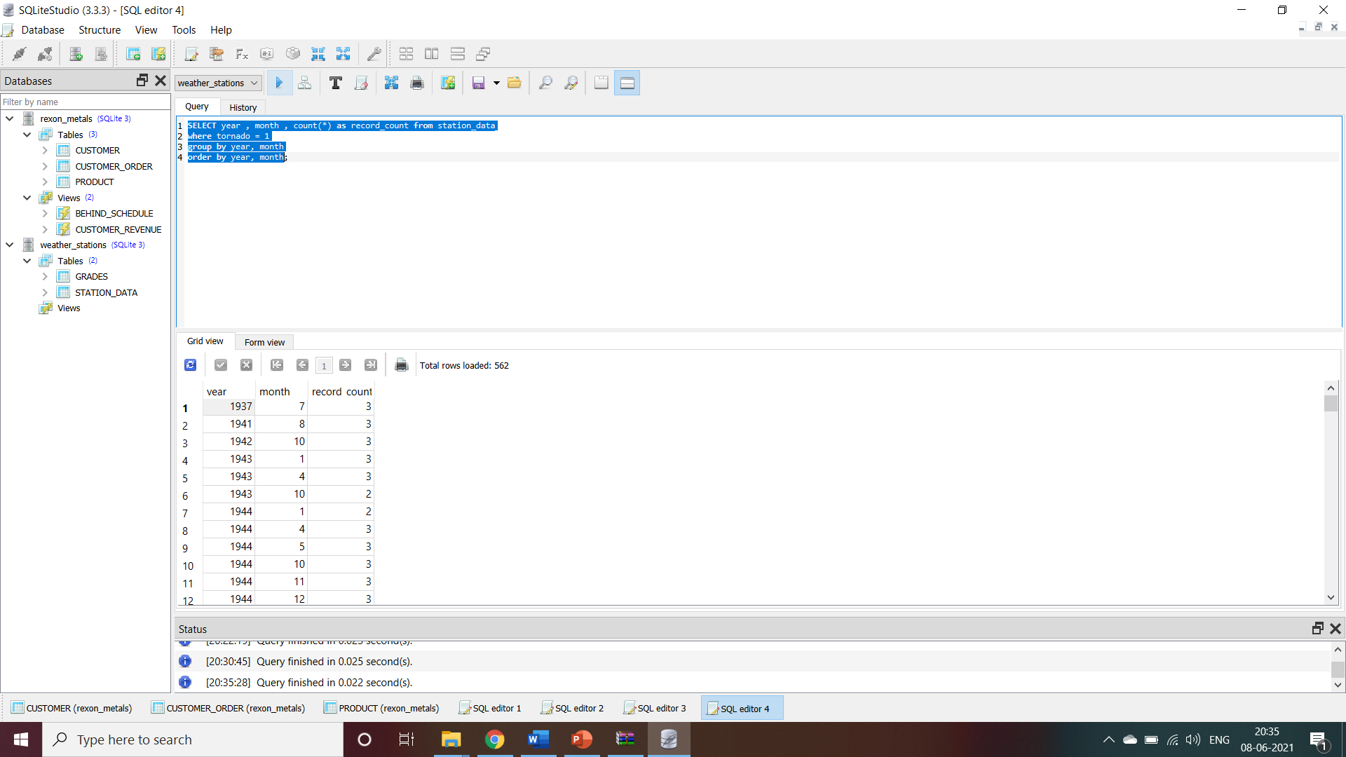

Slide 41
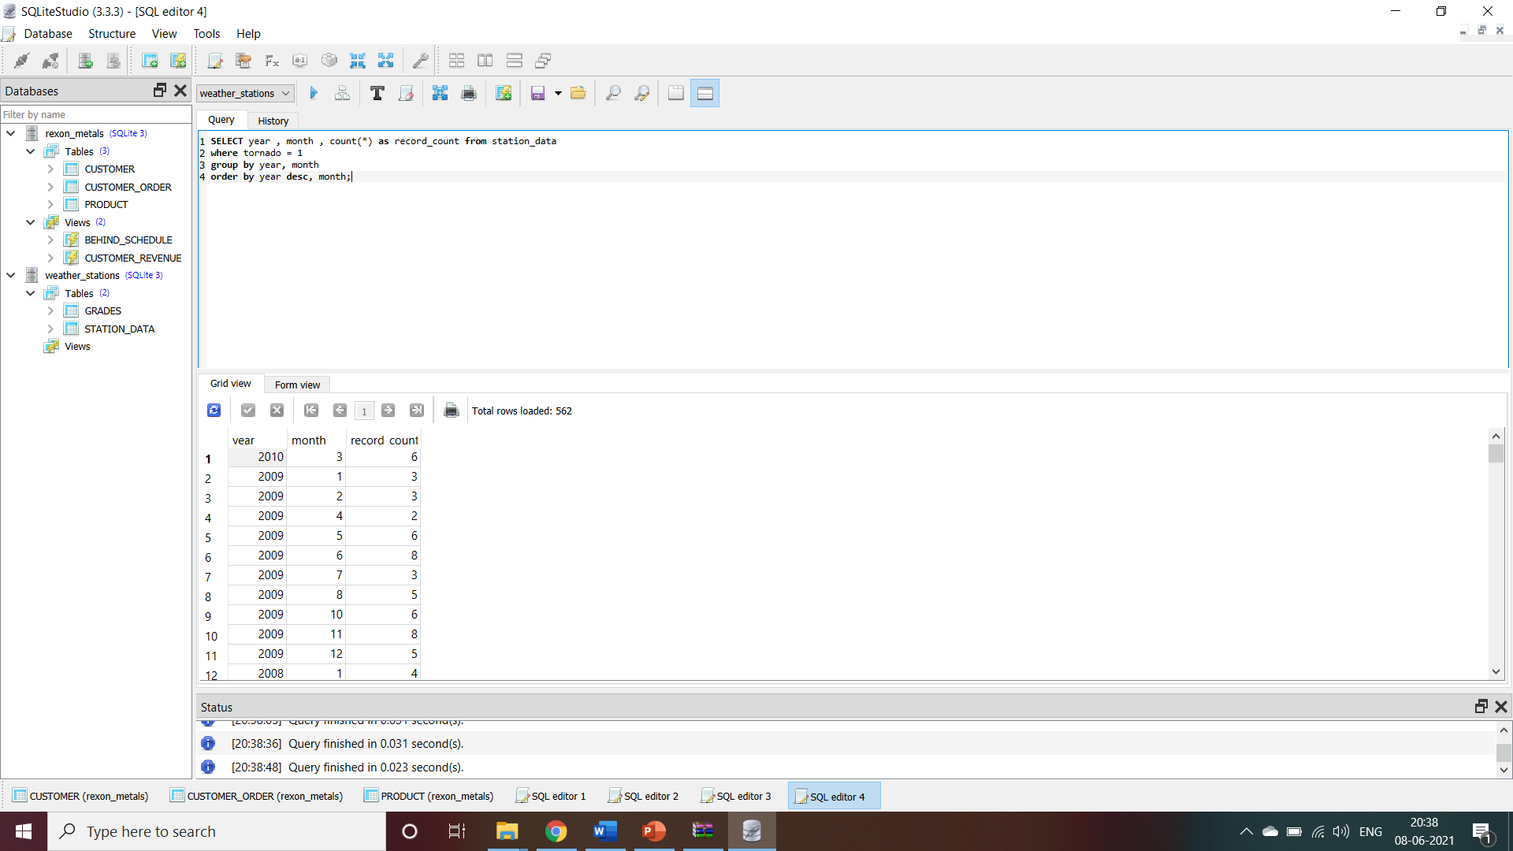

Slide 42
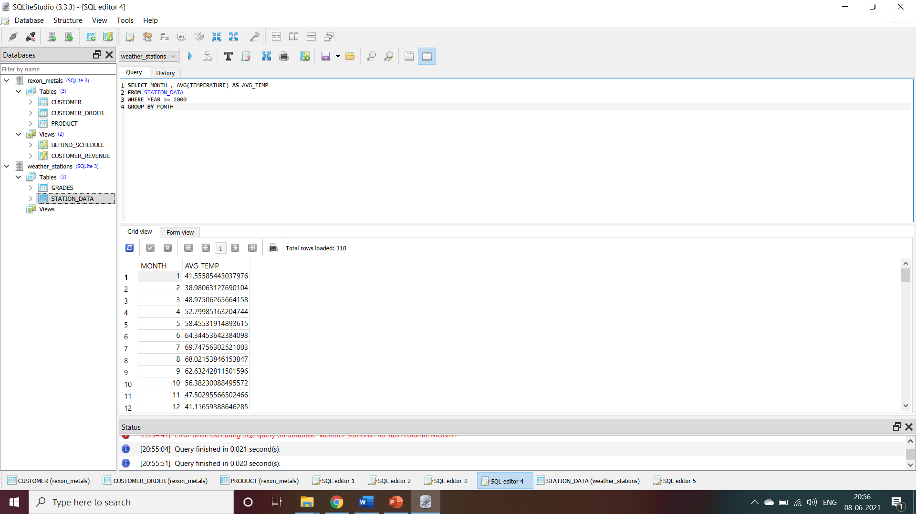

Slide 43
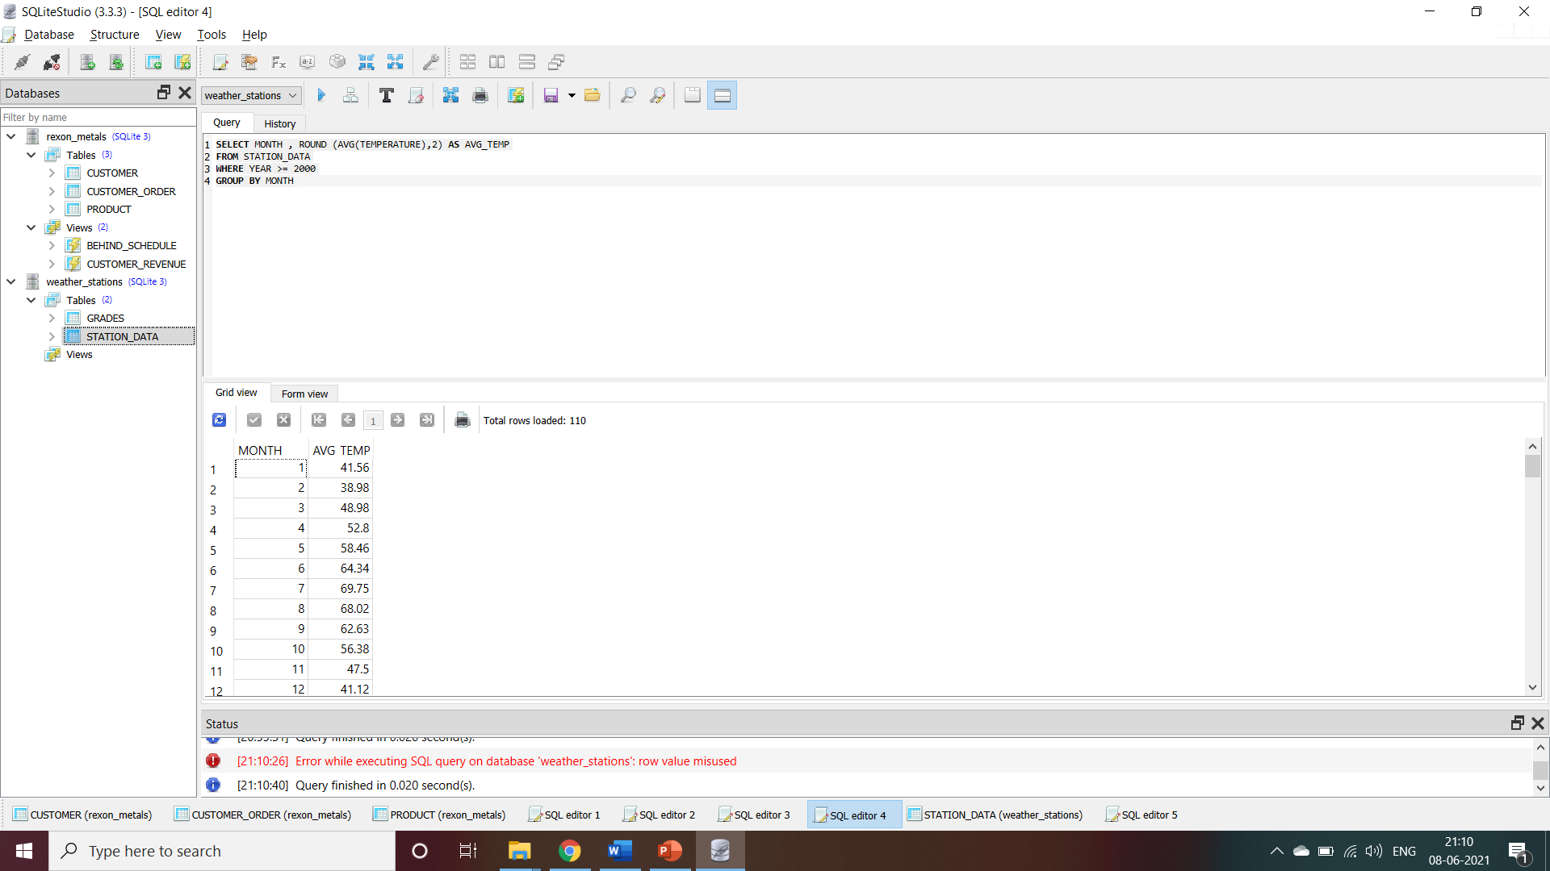

Slide 44
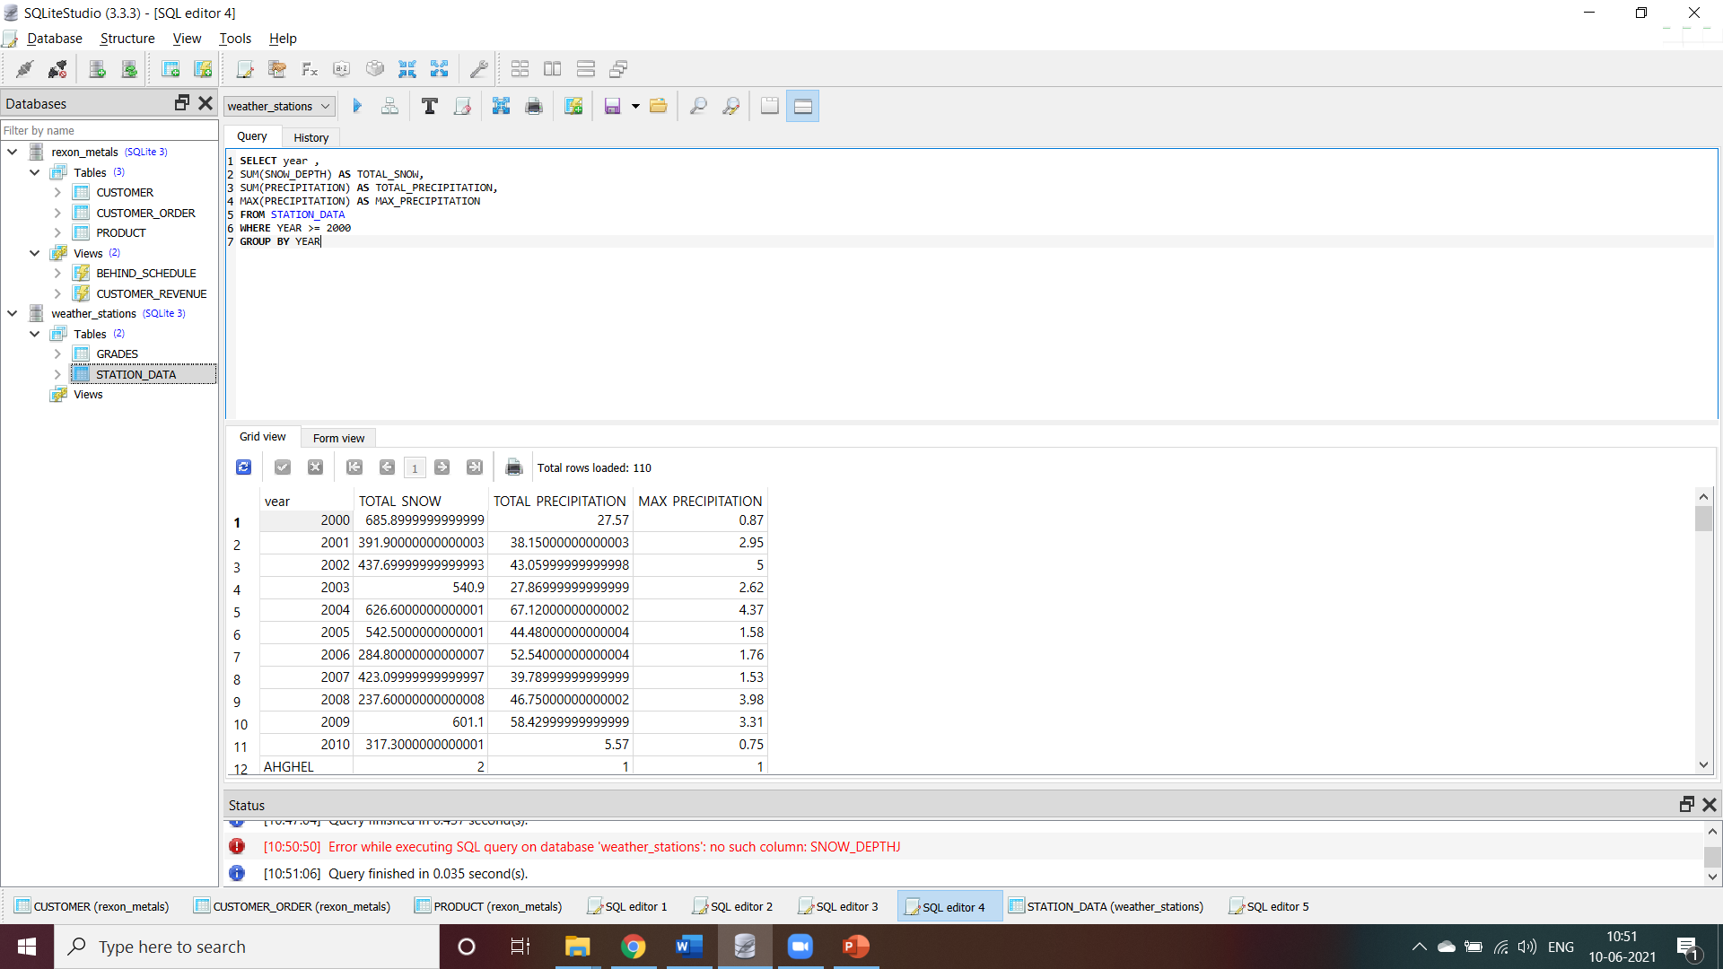

Slide 45
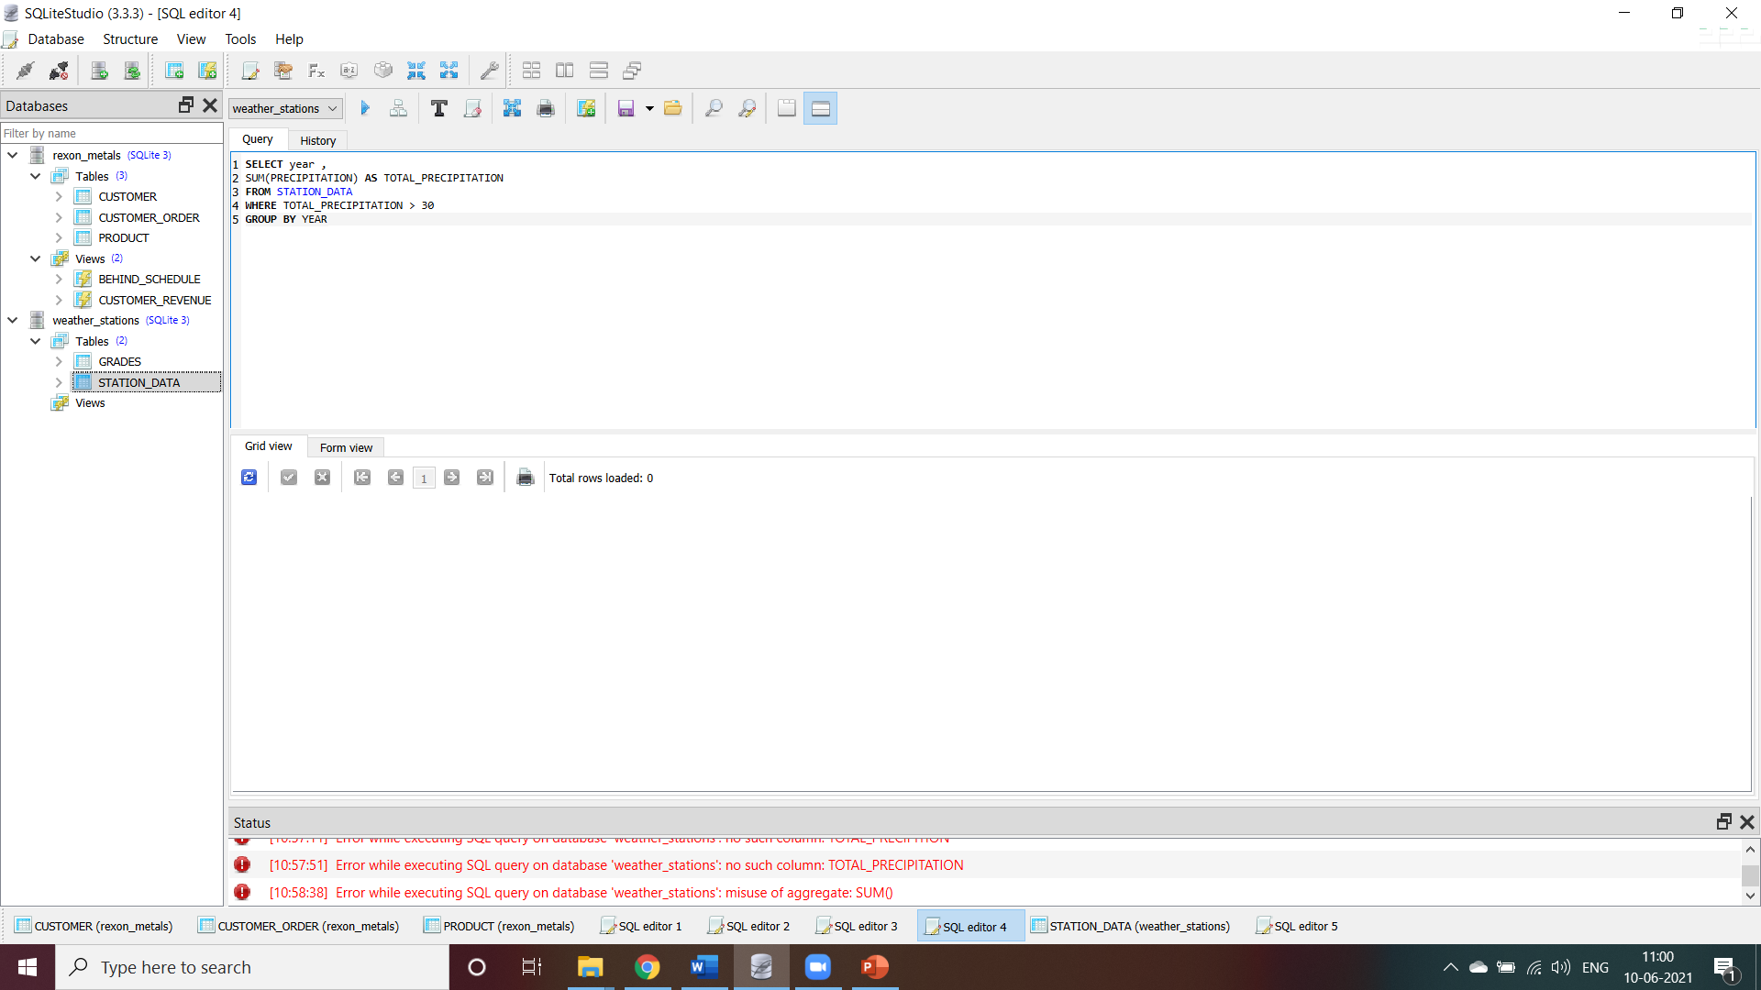

Slide 46
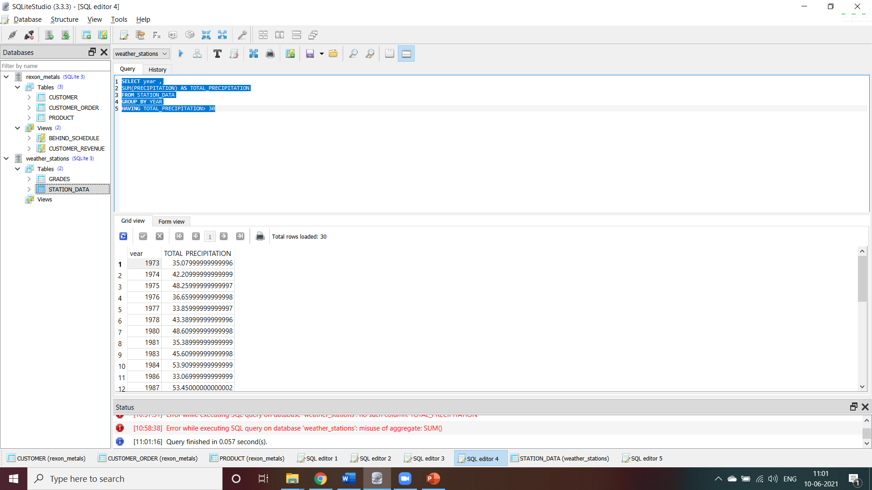

Slide 47
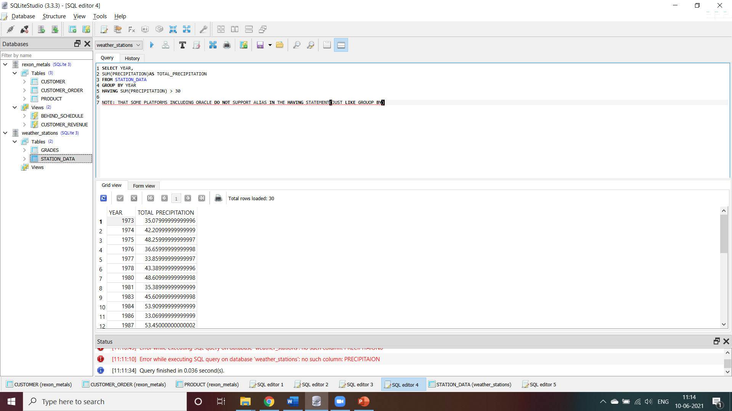

Slide 48
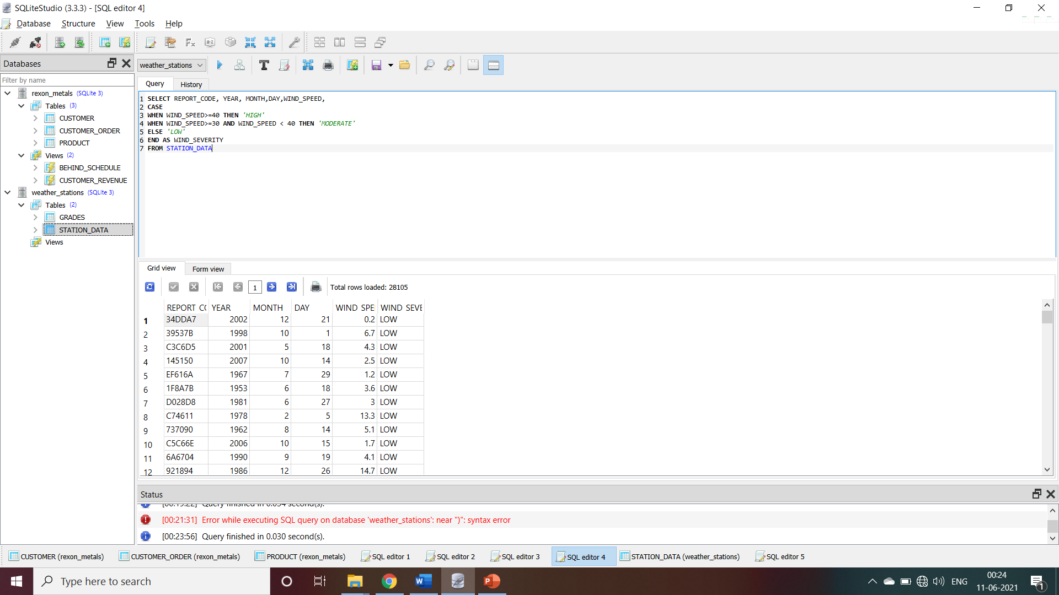

Slide 49
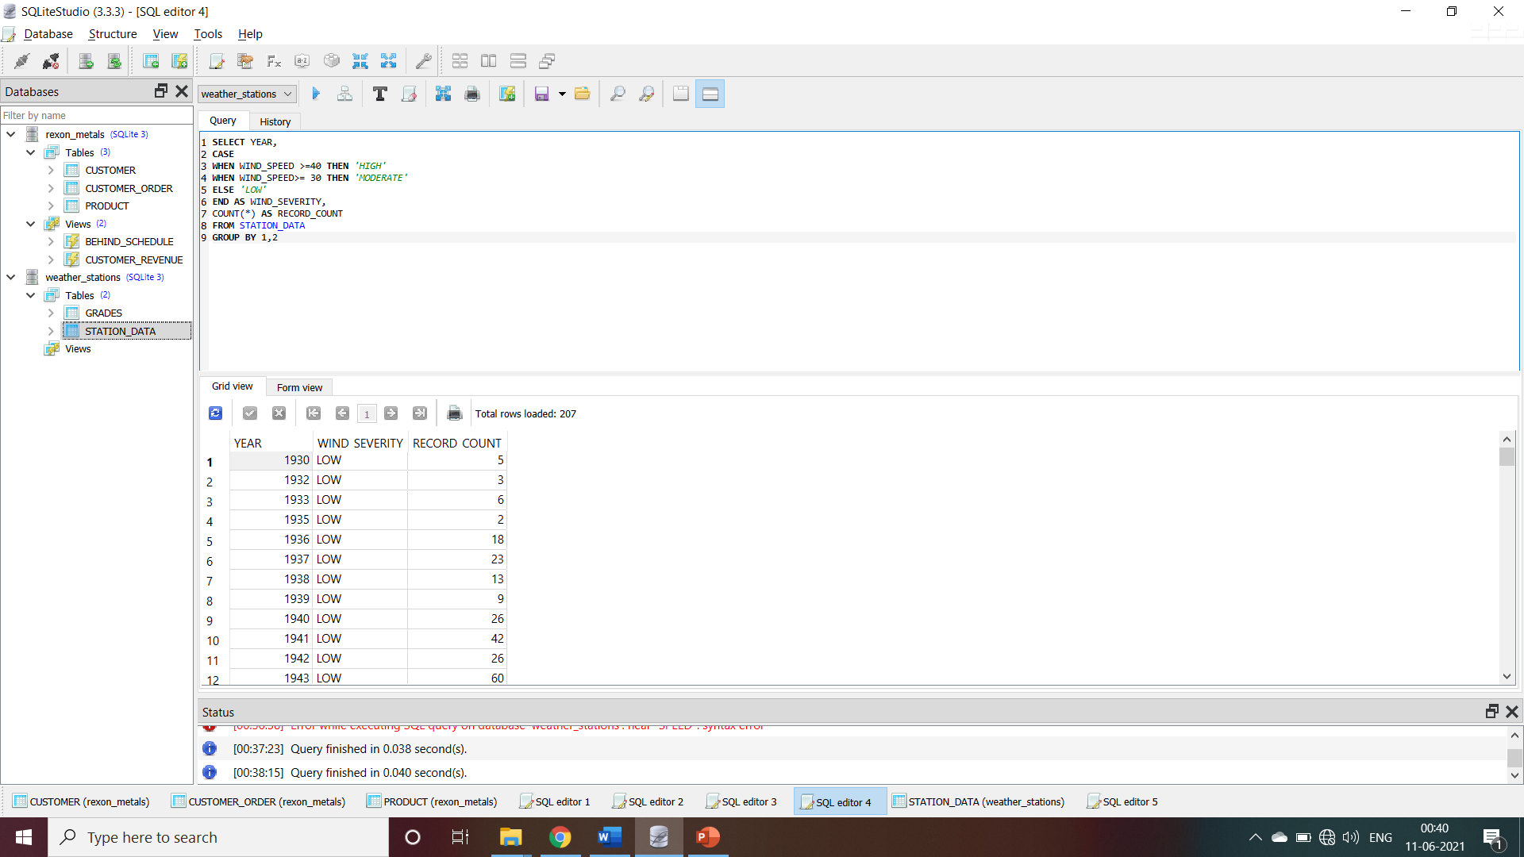

Slide 50
JOIN
PARENT CHILD
CUSTOMER ORDER
1.ORDER ID
2.ORDER DATE
3.SHIP DATE
4.CUSTOMER ID
5.ORDER QTY
CUSTOMER
1.CUSTOMER ID
2.NAME
3.REGION
4.ADRESS
5.CITY
6.POSTAL CODE
7.STATE

Slide 51
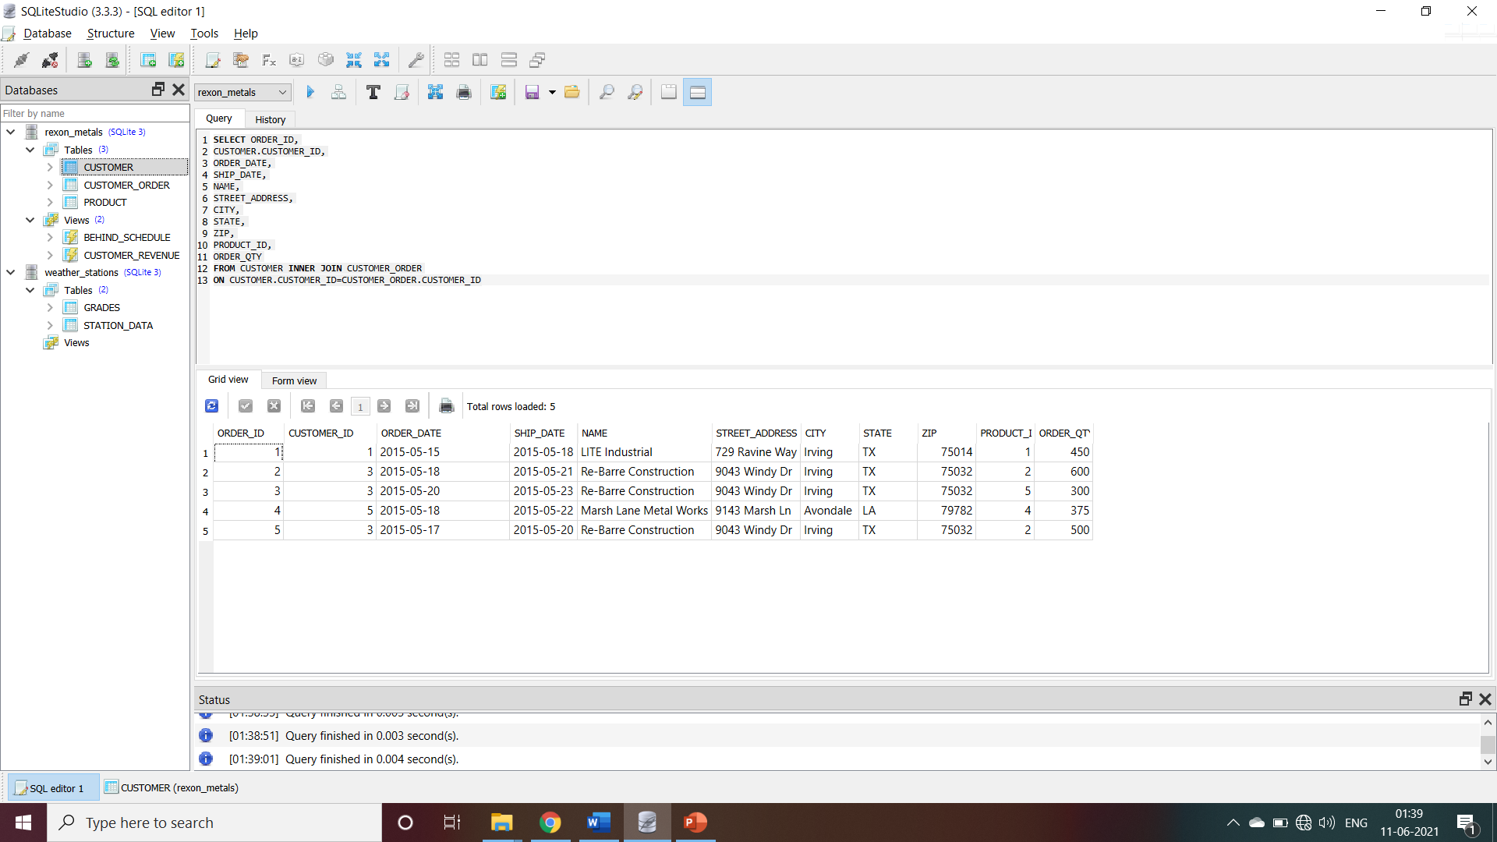

Slide 52
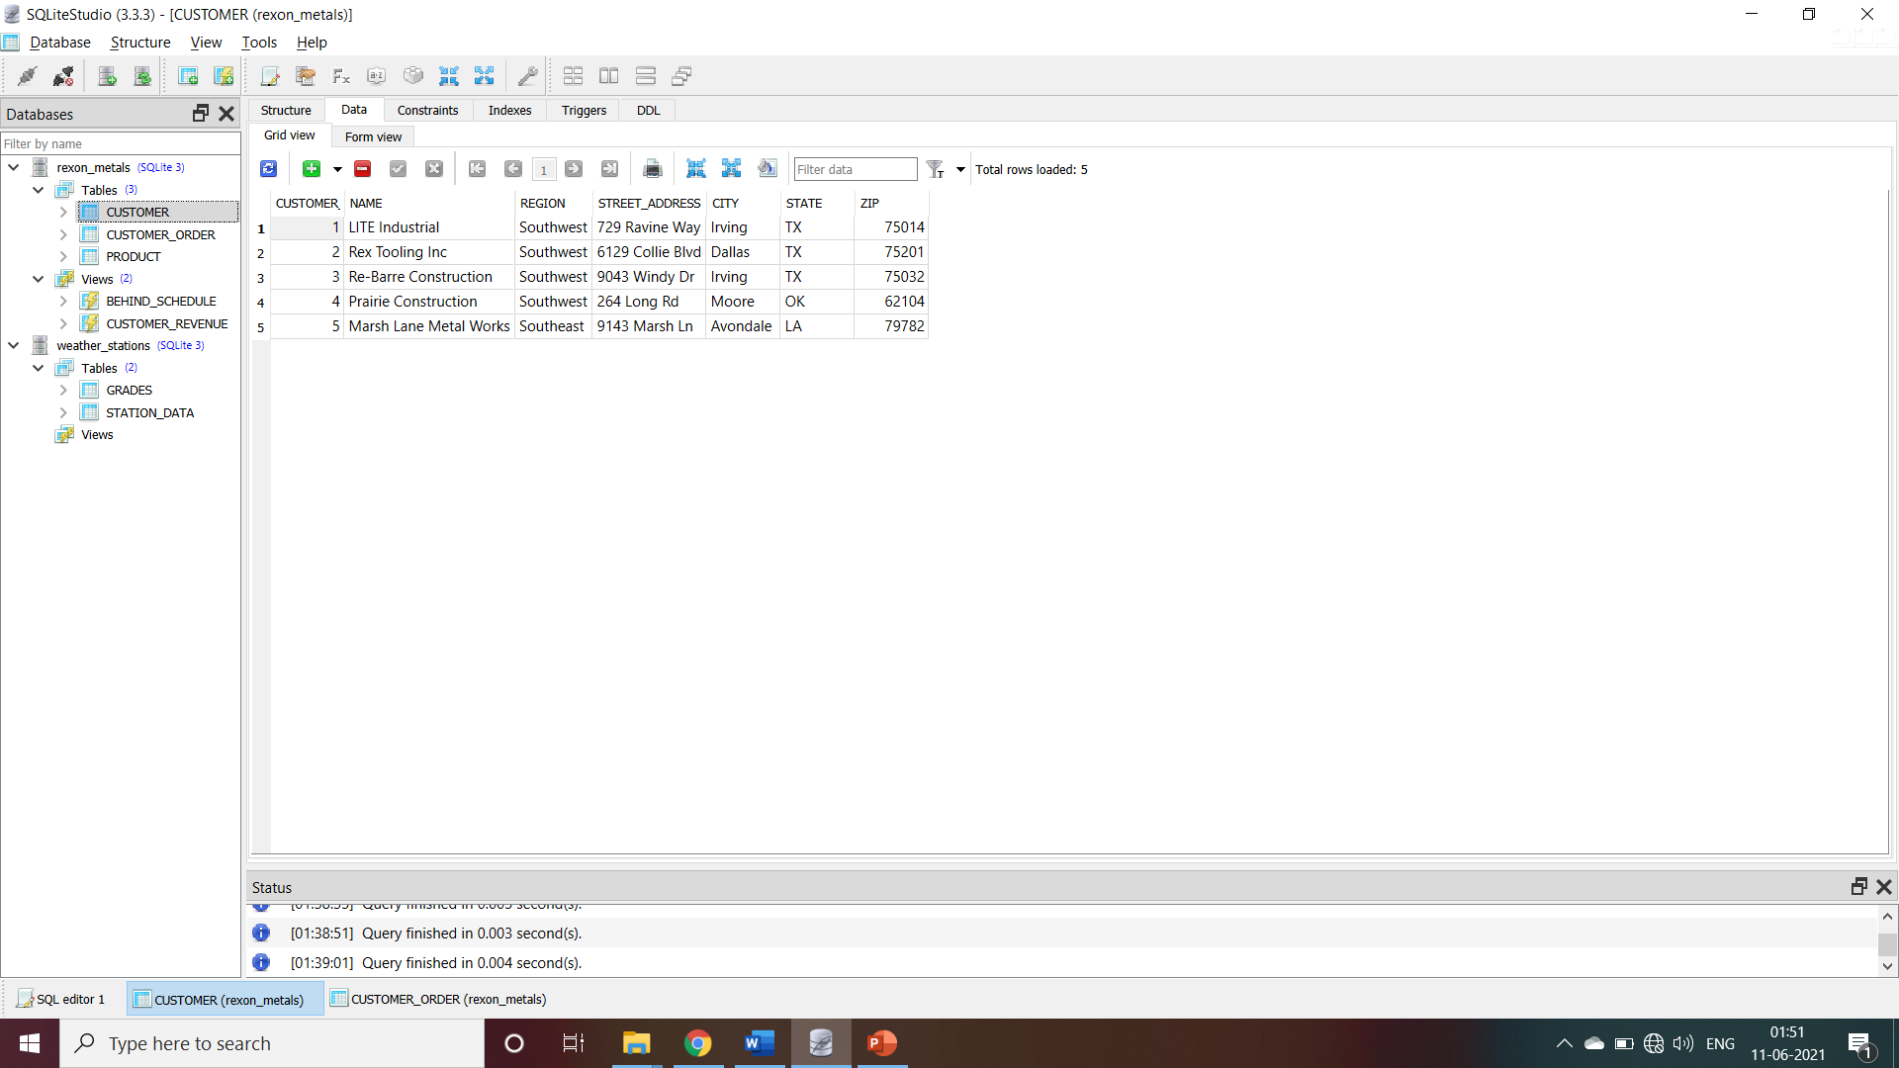

Slide 53
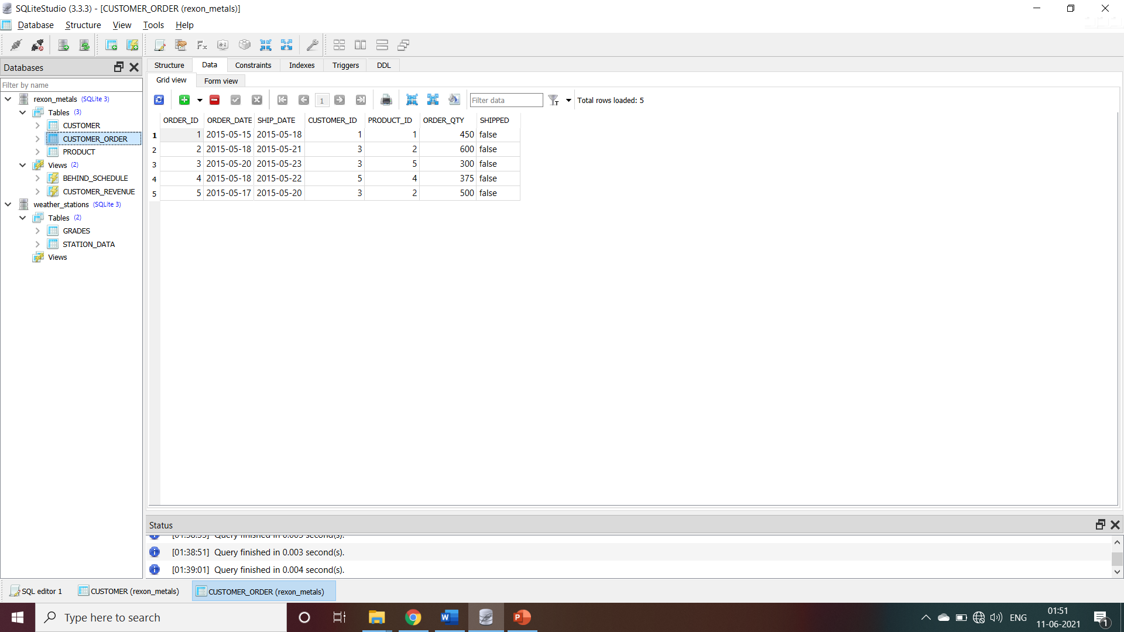

Slide 54

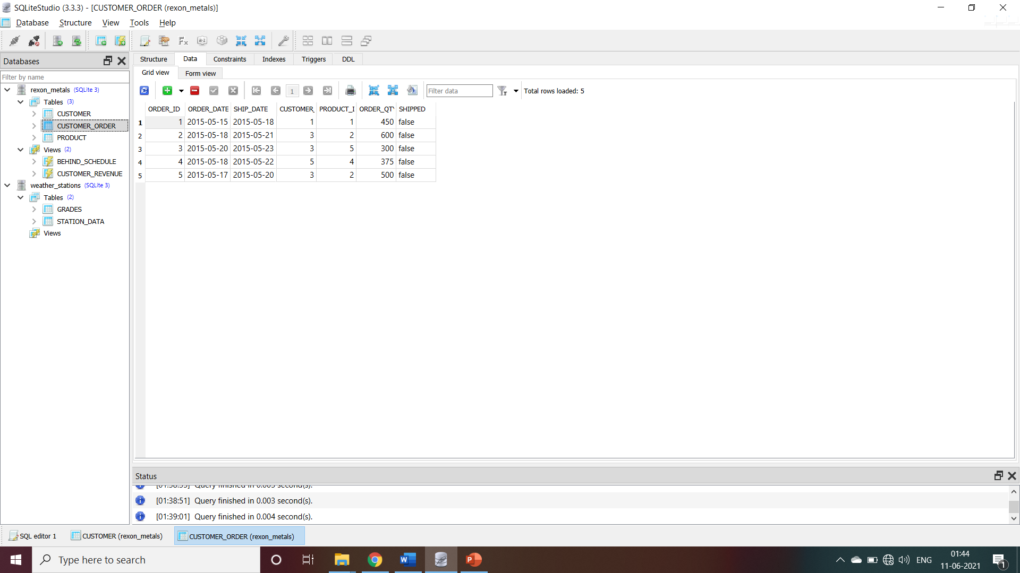

Slide 55
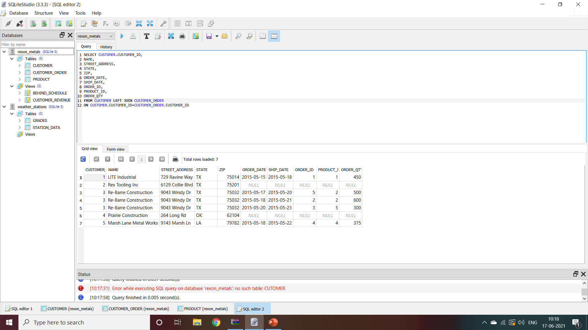
LEFT JOIN

Slide 56
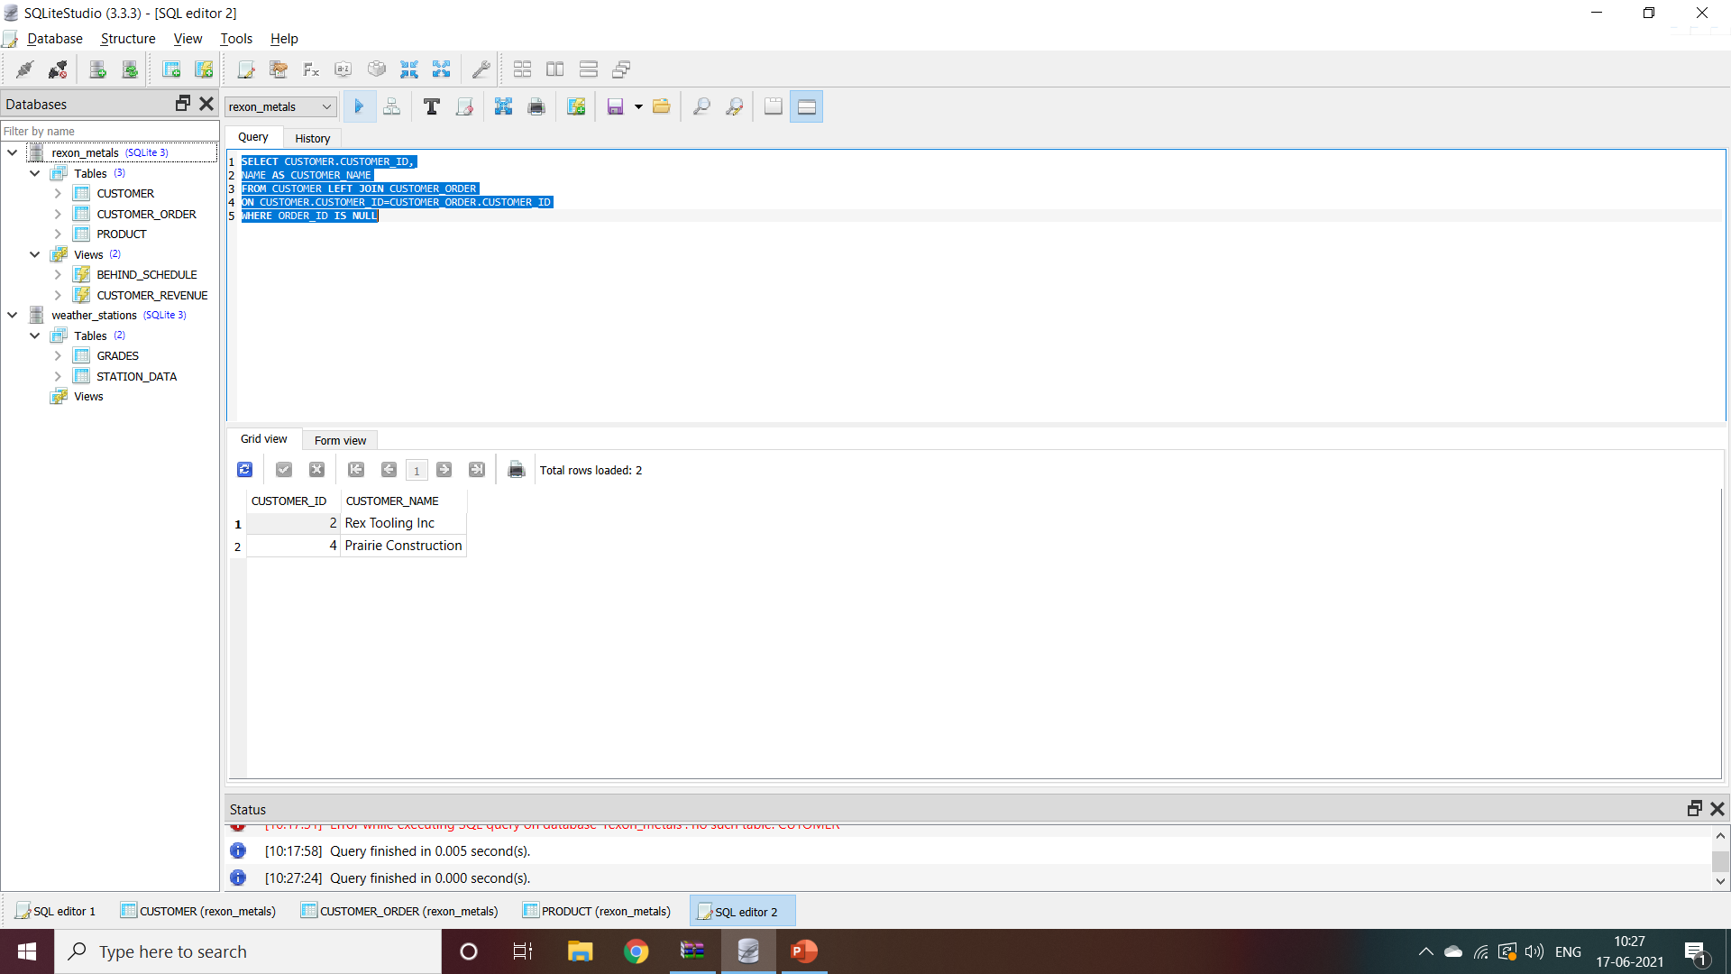
USE WHERE WITH JOIN

Slide 57


Slide 58



Slide 59


Slide 60


Slide 61

GROUPING JOINS

Slide 62


Slide 63


Slide 64


Slide 65
DATABASE DESIGN
WHAT ARE THE BUSINESS REQUIRMENT.
WHAT TABLE WILL I NEED TO FULLFILL THOSE REQUIRMENTS?
WHAT COLOUMN WILL EACH TABLE CONTAIN?
HOW WILL THE TABLE BE NORMALIZED?
WHAT WILL THEIR PARENT/CHILD RELATIONSHIP BE?

Slide 66
DATA QUESTION
HOW MUCH DATA WILL BE POPULATED INTO THESE TABLES?
WHO/WHAT WILL POPULATE THE DATA INTO THESE TABLES?
WHERE WILL THE DATA COME FROM?
DO WE NEED PROCESS TO AUTOMATICALLY POPULATE THE TABLES?

Slide 67
SECURITY QUESTION
WHO SHOULD HAVE ACCESS TO THIS DATABASE?
WHO SHOULD HAVE ACCESS TO WHICH TABLES?
READ-ONLY ACCESS?
WRITE ACCESS?
IS THIS DATABASE CRITICAL TO BUSINESS OPERATIONS?
WHAT BACKUP PLANS DO WE HAVE IN THE EVENT OF DISASTER/FAILURE?
SHOULD CHANGES TO TABLE BE LOGGED?
IF THE DATABASE IS USED FOR WEBSITES OR WEB APPLICATIONS,IS IT SECURE

Slide 68


Slide 69


Slide 70


Slide 71


Slide 72


Slide 73


Slide 74

SAVE CHANGES
DELIT
COLOUMNS
ADD COLOUMNS
EDIT COLOUMNS
CANCLE
CHANGES

Slide 75


Slide 76


Slide 77


Slide 78


Slide 79


Slide 80


Slide 81


Slide 82


Slide 83


Slide 84


Slide 85


Slide 86


Slide 87


Slide 88


Slide 89


Slide 90


Slide 91


Slide 92


Slide 93


Slide 94


Slide 95


Slide 96


Slide 97
HH:MM:SS

Slide 98


Slide 99


Slide 100
Transactions in SQL
A transaction is the propagation of one or more changes to the database.
For example:- If you are creating a record or updating a record or deleting a record from the table, then you are performing a transaction on that table.
It is important to control these transactions to ensure the data integrity and to handle database errors.

Slide 101
ACID
A :-Atomicity
C :-Consistency
I :-Isolation
D :-Durability

Slide 102
Atomicity
Ensures that all operations within the work unit are completed successfully. Otherwise, the transaction is aborted at the point of failure and all the previous operations are rolled back to their former state.

Slide 103
Consistency
Ensures that the database properly changes states upon a successfully committed transaction.

Slide 104
Isolation
Enables transactions to operate independently of and transparent to each other.

Slide 105
Durability
Ensures that the result or effect of a committed transaction persists in case of a system failure.

Slide 106
DEADLOCK
In a database, a deadlock is a situation in which two or more transactions are waiting for one another to give up locks.
For example, Transaction A might hold a lock on some rows in the Accounts table and needs to update some rows in the Orders table to finish. Transaction B holds locks on those very rows in the Orders table but needs to update the rows in the Accounts table held by Transaction A. Transaction A cannot complete its transaction because of the lock on Orders. Transaction B cannot complete its transaction because of the lock on Accounts. All activity comes to a halt and remains at a standstill forever unless the DBMS detects the deadlock and aborts one of the transactions. The following figure shows this situation.

Slide 107
Transaction Control
COMMIT − to save the changes.
ROLLBACK − to roll back the changes.
SAVEPOINT − creates points within the groups of transactions in which to ROLLBACK.
SET TRANSACTION − Places a name on a transaction

Slide 109
END

